Slide 1

Blood Bank Management System
Presented By :-
Gayakwad Siddhant g
Sharma Harsh
Satodiya Shrey

Slide 3
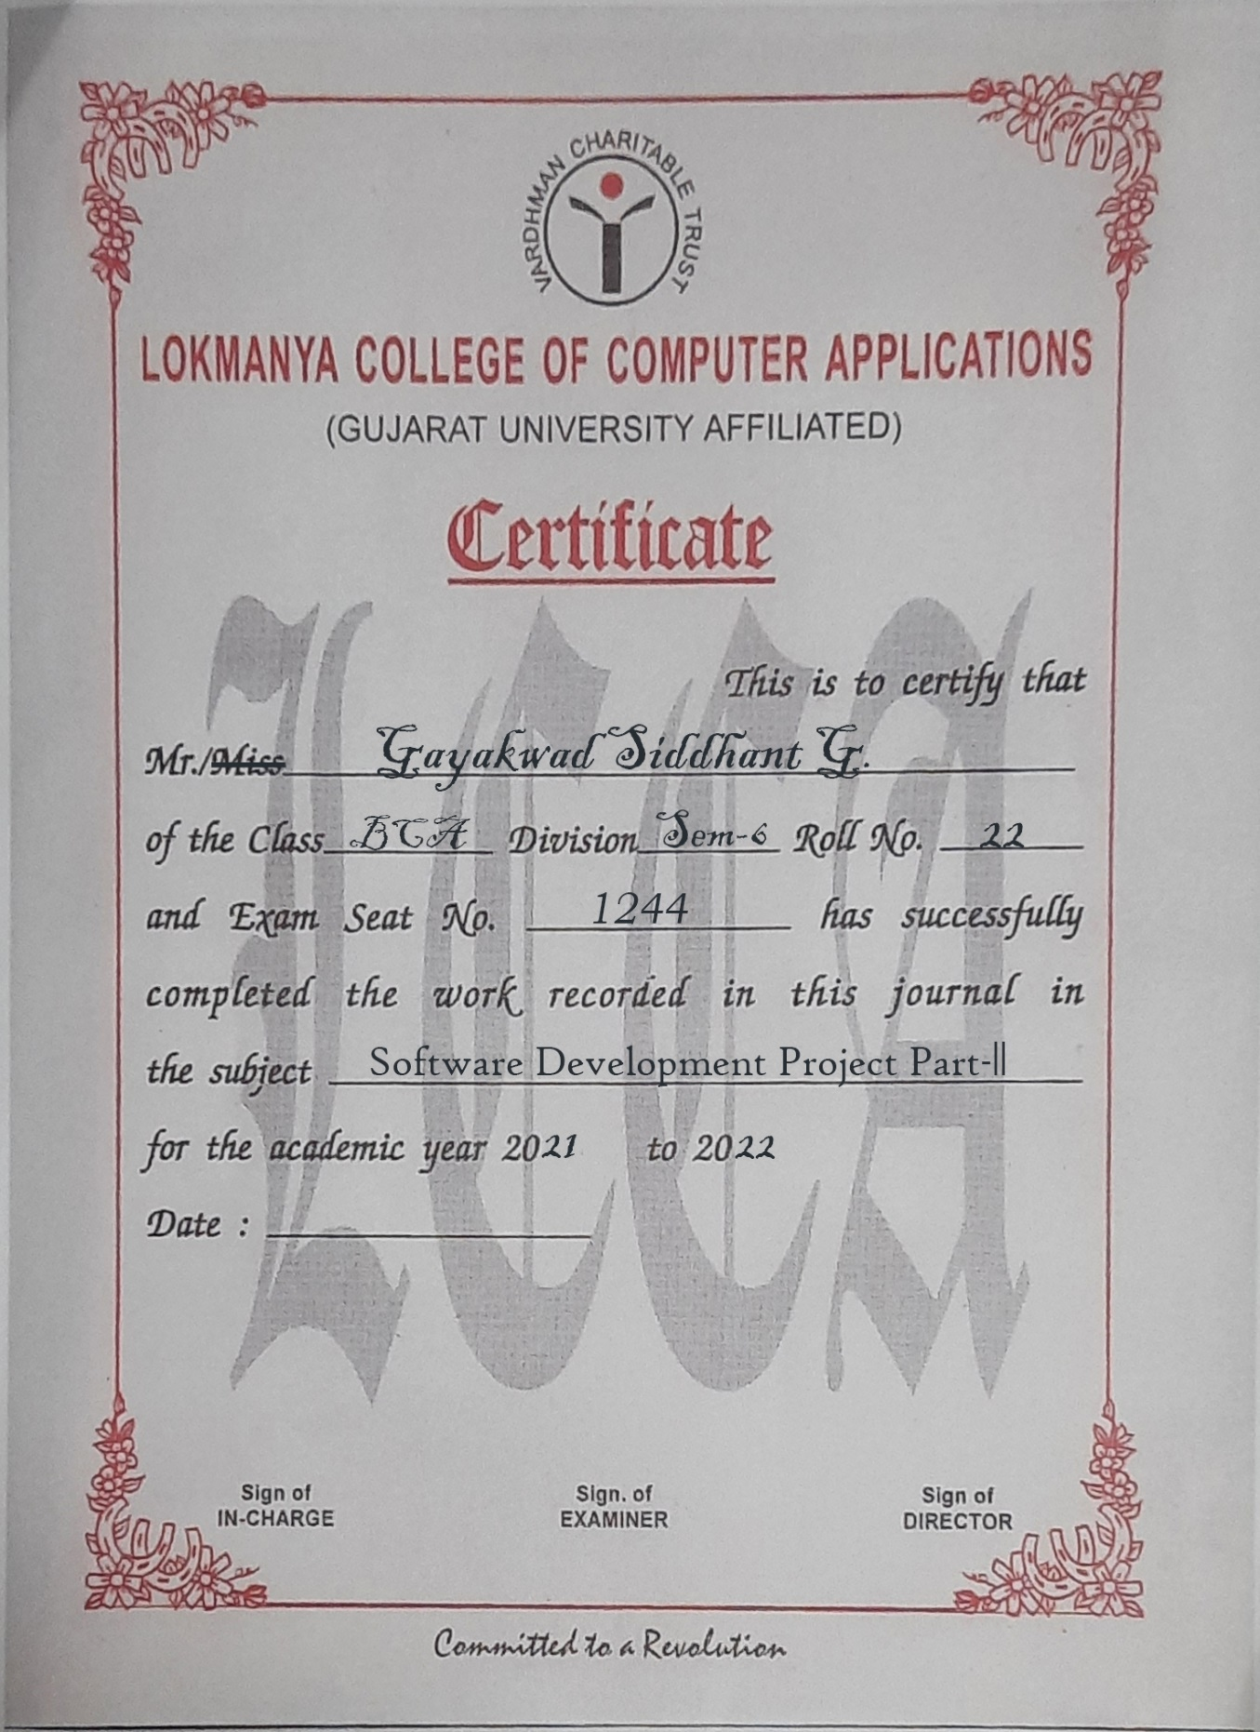
COMPANY LETTER

Slide 4
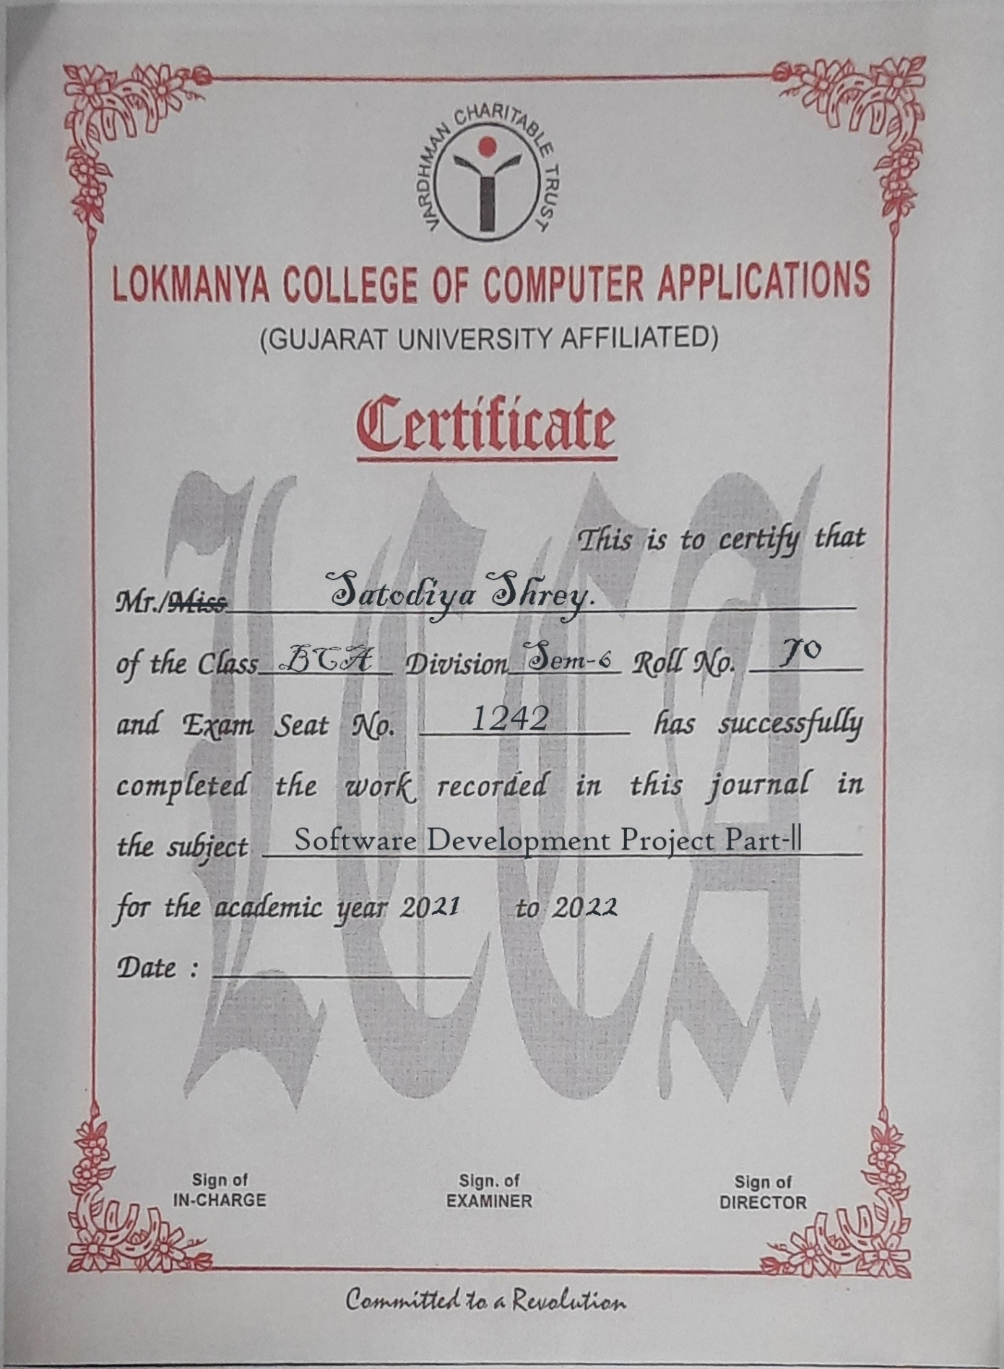
COMPANY LETTER

Slide 5
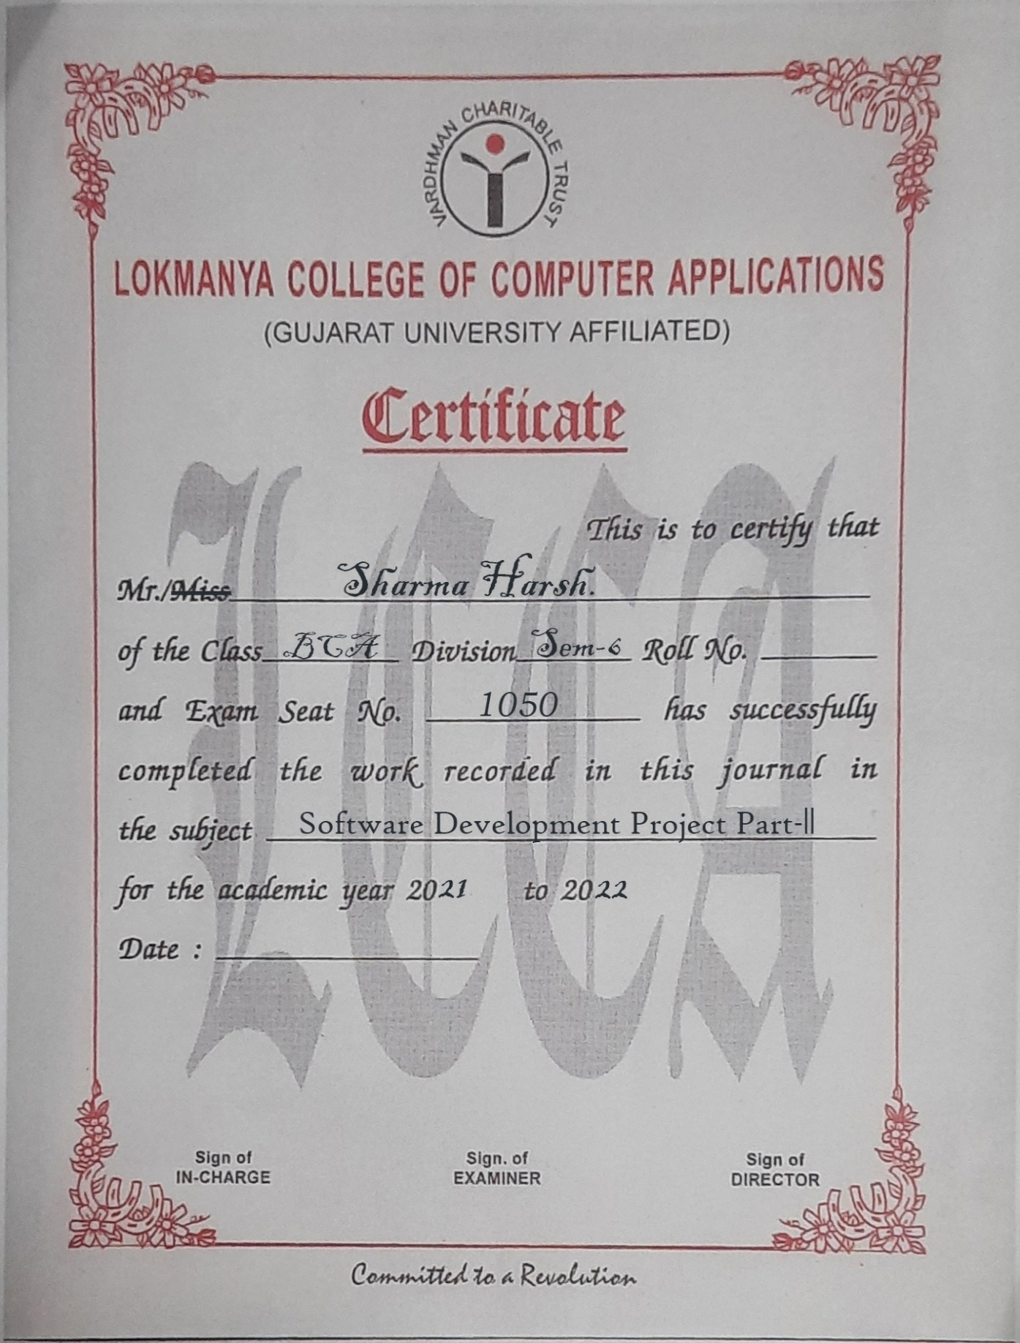
COMPANY LETTER

Slide 6
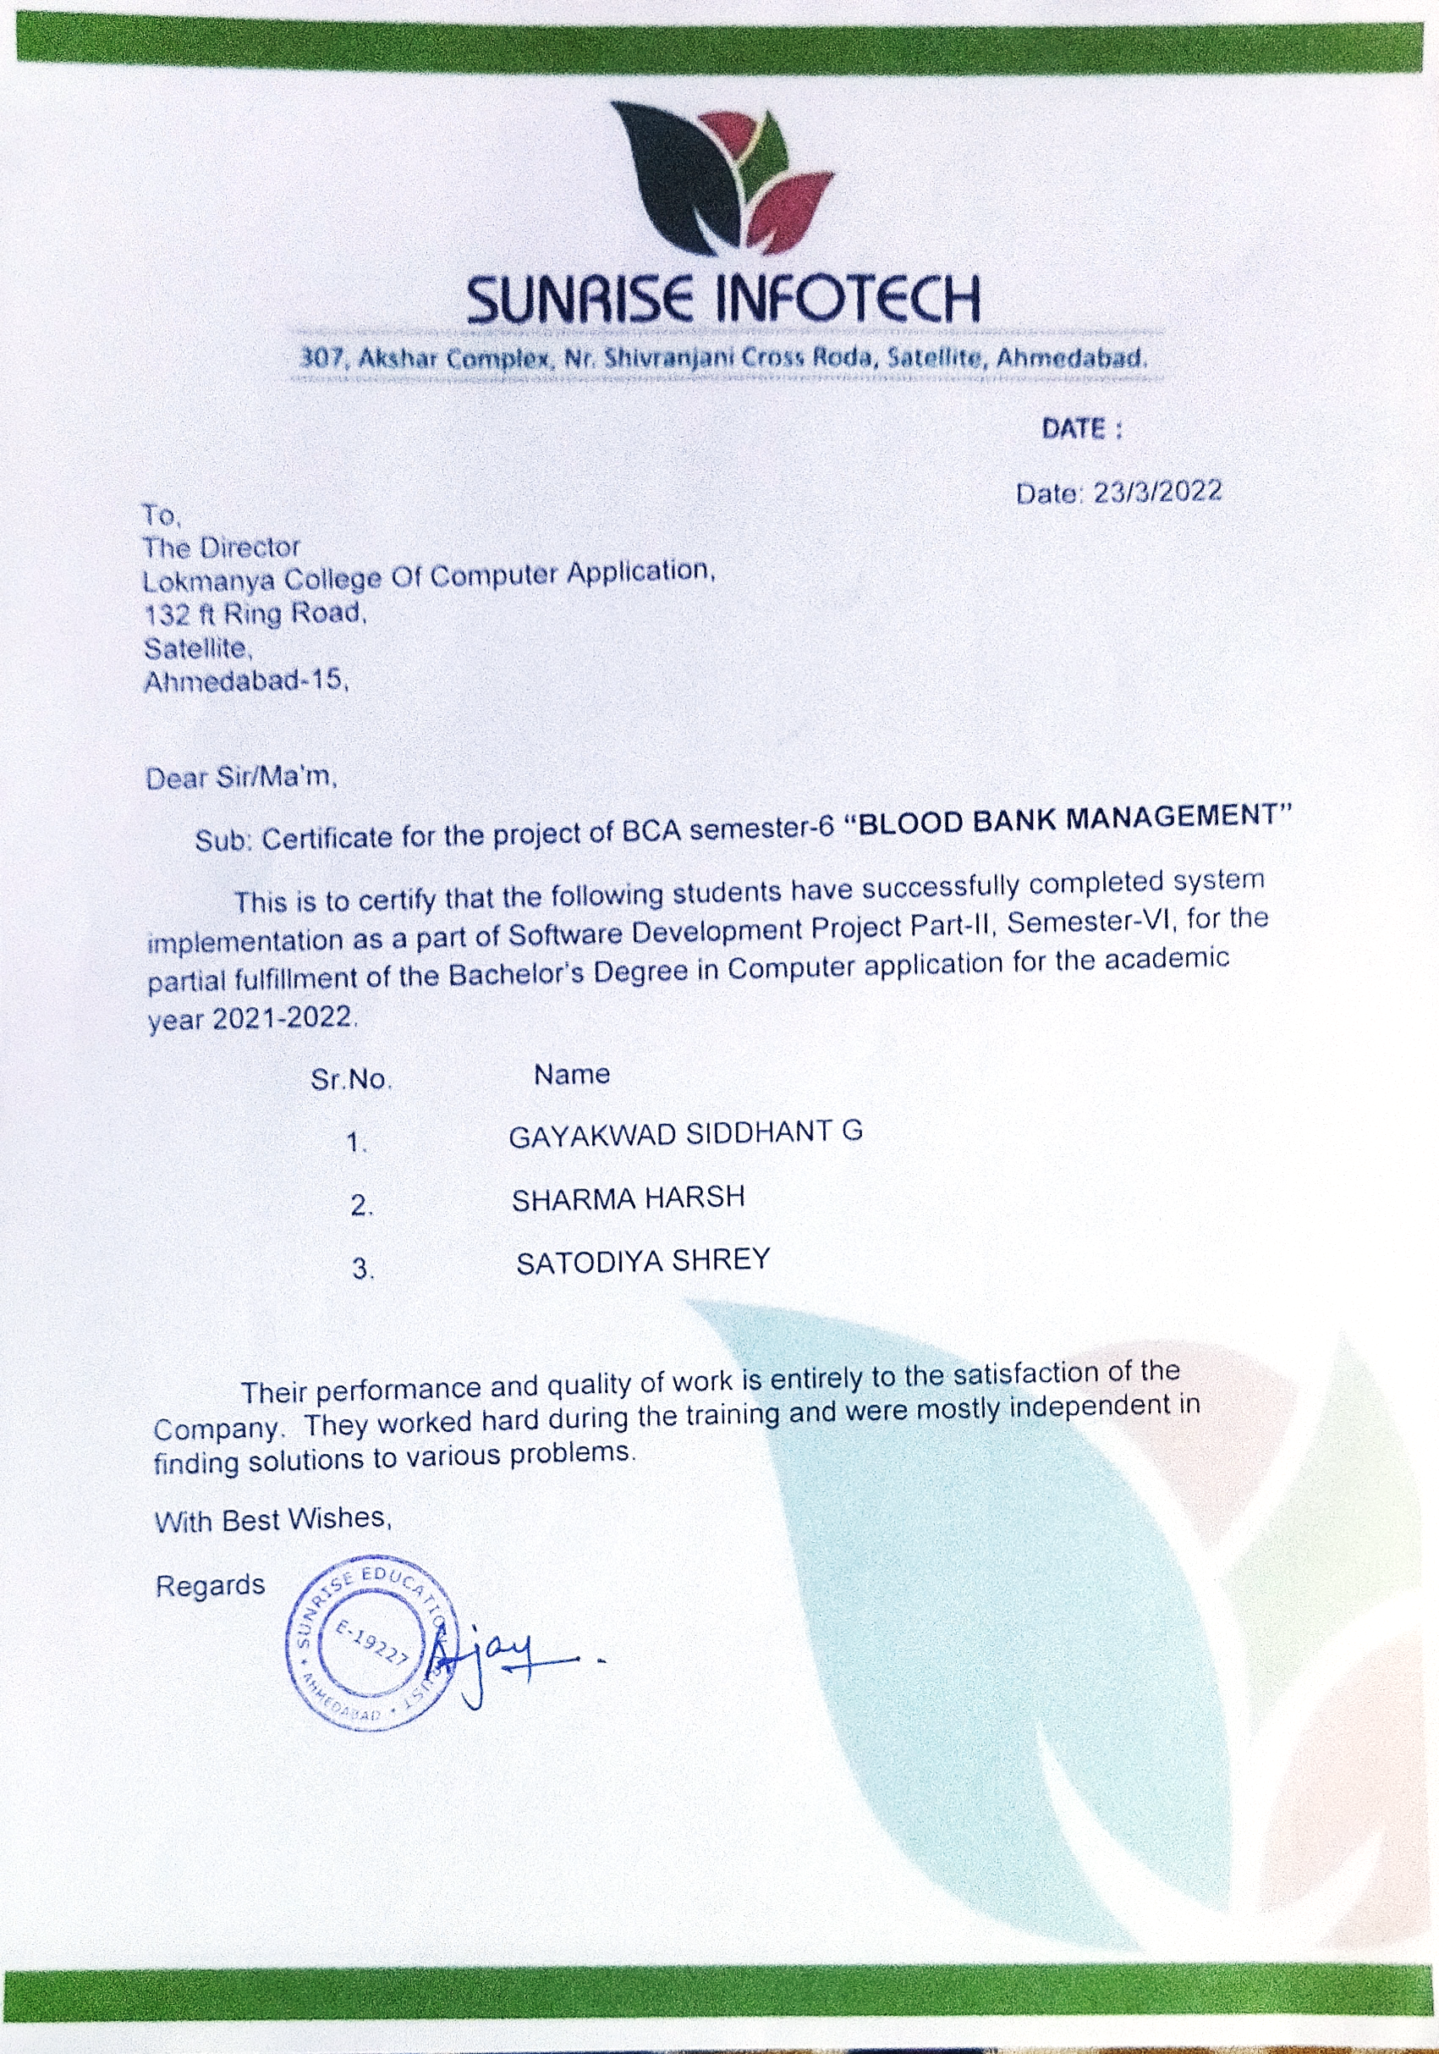
COMPANY LETTER

Slide 7
No. TITLE Page
1. | Introduction | __
 | 1.1 Group Details | __
 | 1.2 Introduction
 | 1.3 Need for New System
 | 1.4 Tools and Technology
2. | LAYOUT | __
 | 2.1 Screen Layout | __
 | 2.2 Report Layout | __
3. | FUTURE ENHANCEMENT | __
4. | CONCLUSION | __
5. | BIBLIOGRAPHY | __
INDEX

Slide 8


Acknowledgement
Towards of Our Bachelor of Computer Application project training in Lokmanya college of Computer Application.
We have sincerely graduate to college facilities (project Guide) of Lokmanya College of computer application Ahmedabad providing this opportunity and necessary support during analysis of the project.
We are also grateful to all staff members of this company for providing all technical assistance and helping for solving problems arising during analysis.
We have no other words to express my sincere thanks to all Our lectures of Lokmanya college of computer Application, Ahmedabad for their kind co-operation and able guidance.
Especially to All Facilities Our internal project Guide in college who also guide us in Our project.

Slide 9
introduction
Management System motive at maintaining all the information related to blood donors, different blood groups available in Our blood bank and help them manage in a better way.
The project blood bank management known to be a pilot project that is design for the blood bank together blood from various source & distribute is to the nearby people who have highly requirement for it .
The software is designed to handle the daily transection of the blood bank & search the detail when required.
It’s also help to register have to donor blood collection as well as blood issue report.
The software application is designed in such as manner that it can suit the need of all the blood bank requirement in course of future.

Slide 10
Abstract
The purpose of Blood bank data abstract php project study was to develop blood management information system to assist in the management of blood donor records and or control the distribution of blood in various parts of the country basing on the hospital demands.
Without quick and timely access to donor records, creating market strategies of blood donor becomes very difficult.
The blood management system offers functionality to quick access to donor records collected various parts of the country.
It enables monitoring of the results and performance of the blood donation activity such that relevant and measurable objectives of the organization can be checked.

Slide 11
Project Profile
Project Title | BLOOD BANK Management System
Group Size | 3 Members
Group Members | 1. Gayakwad Siddhant G 2. Satodiya Shrey. 3. Sharma Harsh.
Internal Guide | All Faculty members
External Guide

Slide 12

COMPANY Profile
TITLE | DESCRIPTION
Company Name | Sunrise Infotech
Logo
Development | PHP, MY SQL SERVER
Address | 307, Akshar Complex, Nr.Shivranjani Cross Road, Satellite, Ahmedabad-15
Owner | XYZ
Web Site | www.sunriseinfotech.com
E mail ID | SunRiseInfotech@gmail.com

Slide 13
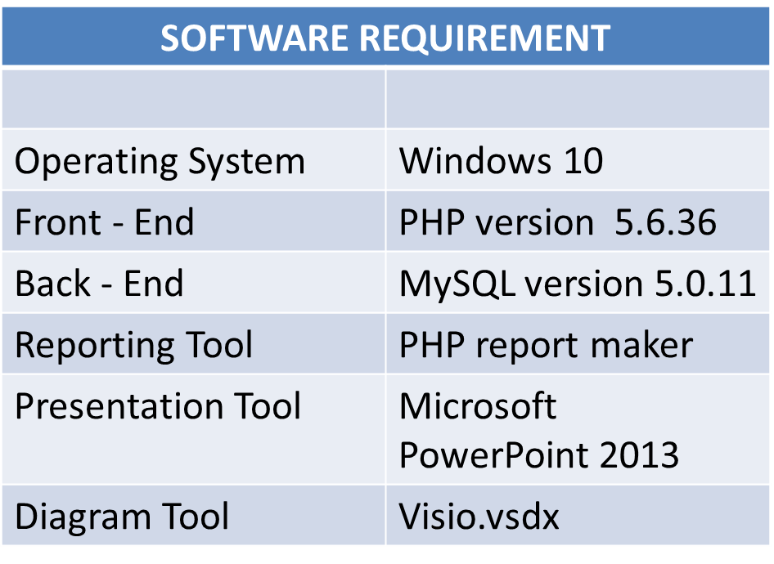
Tools & TECHNOLOGY
HARDWARE REQUIREMENT
Processor | Intel Core i3
Memory | 2 GB
Hard Disk | 1 TB

Slide 14
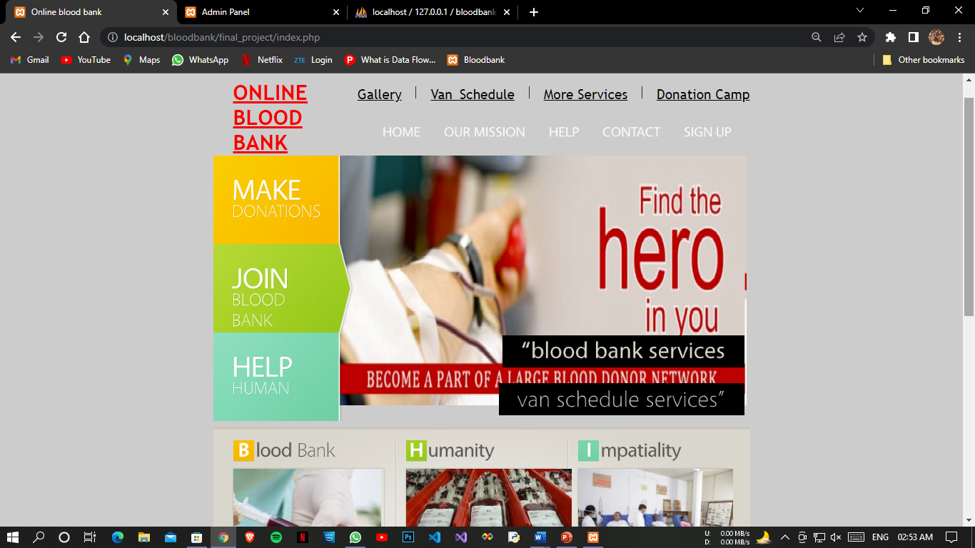
USER
Home Page

Slide 15
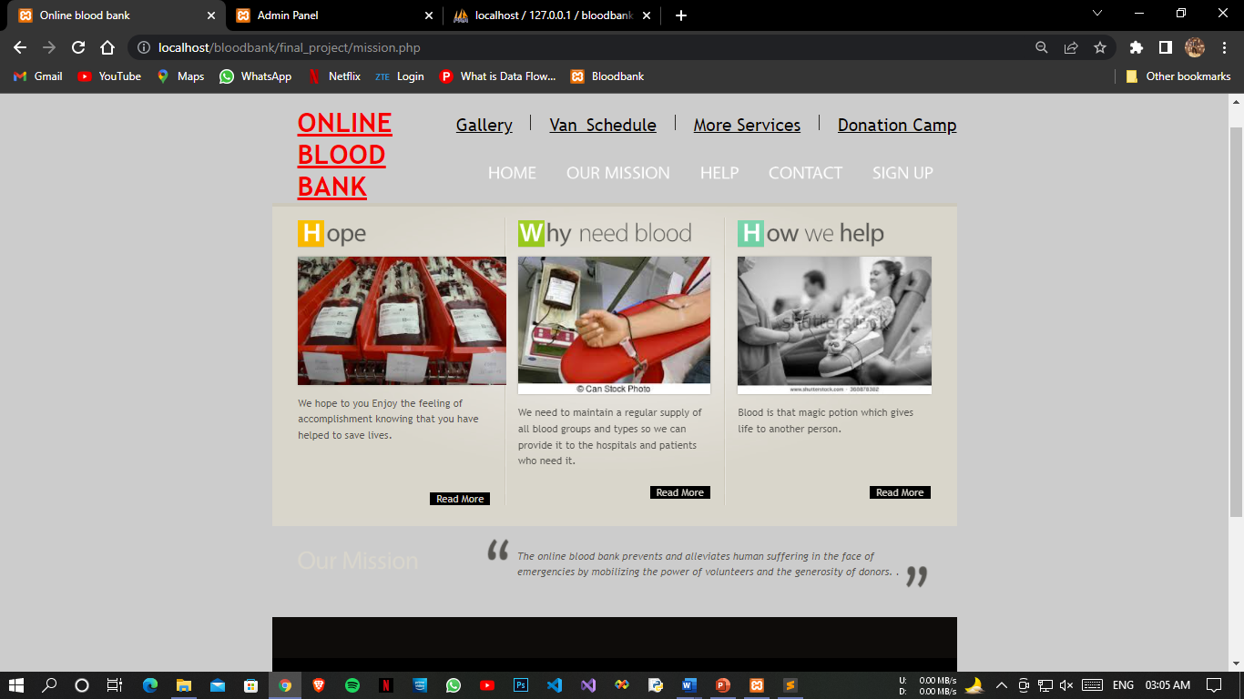
Our Mission

Slide 16
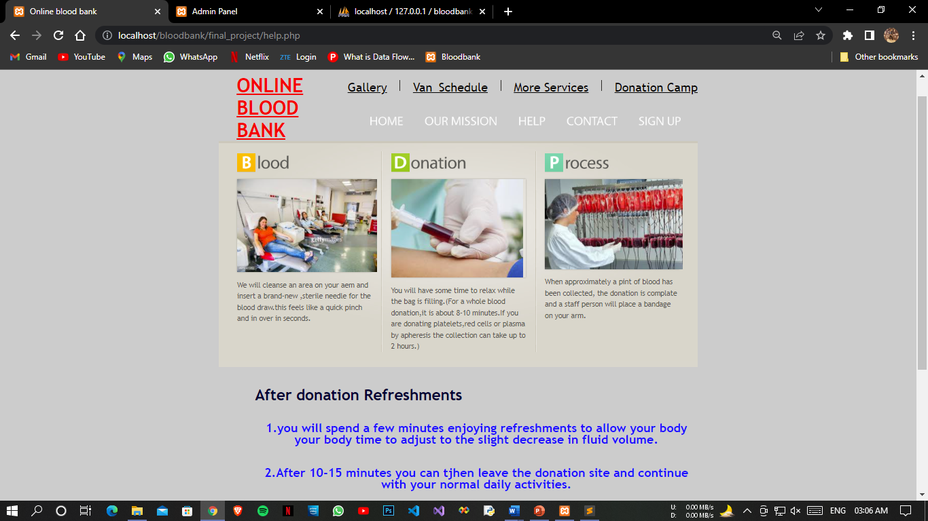
Help Page

Slide 17
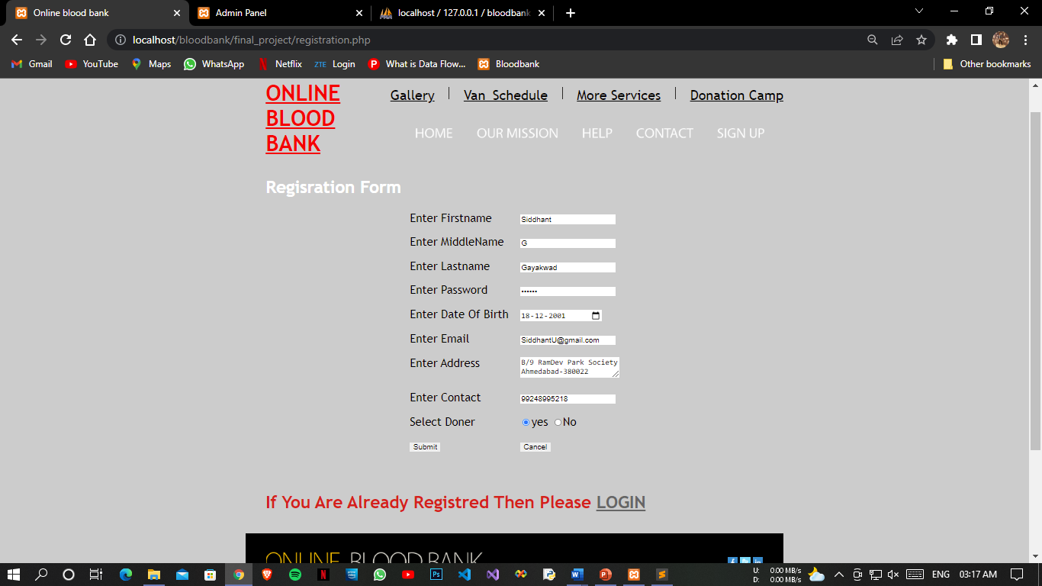
Registration Form

Slide 18
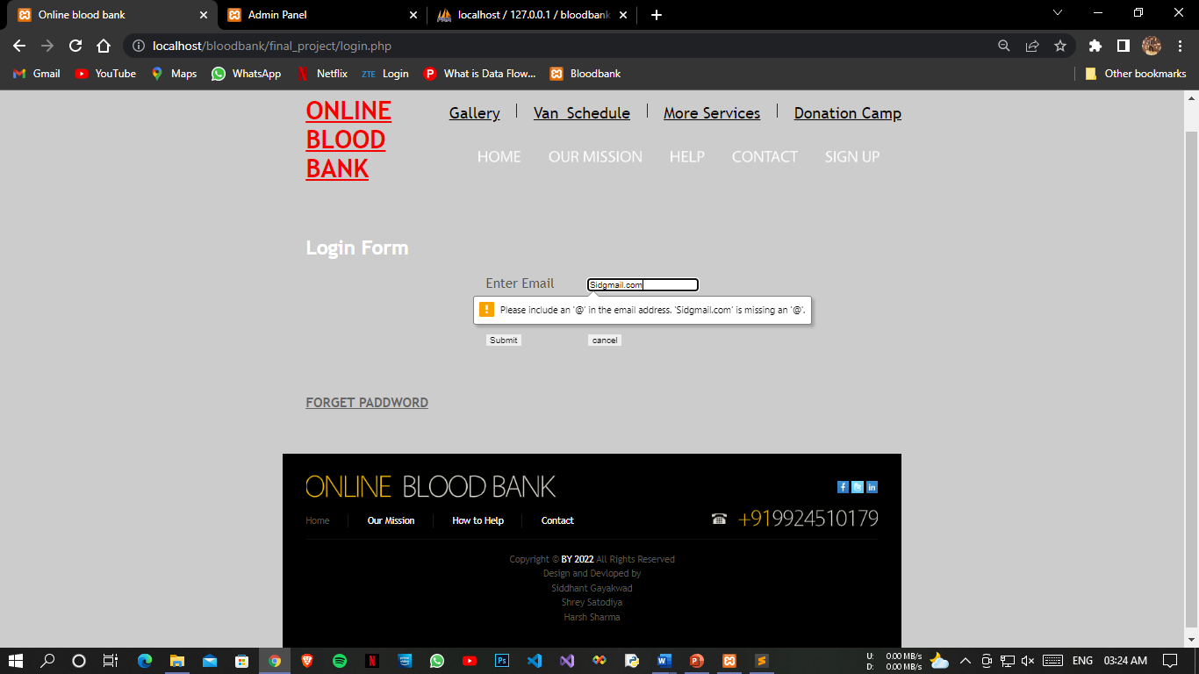
Login Validation Error

Slide 19
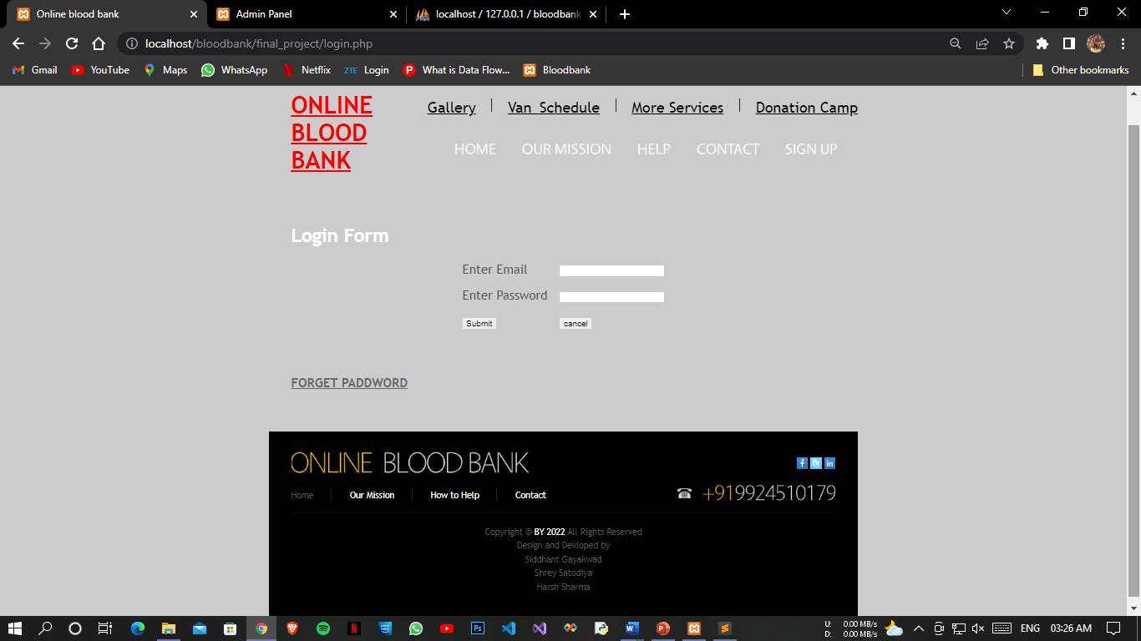
Login Error Page

Slide 20
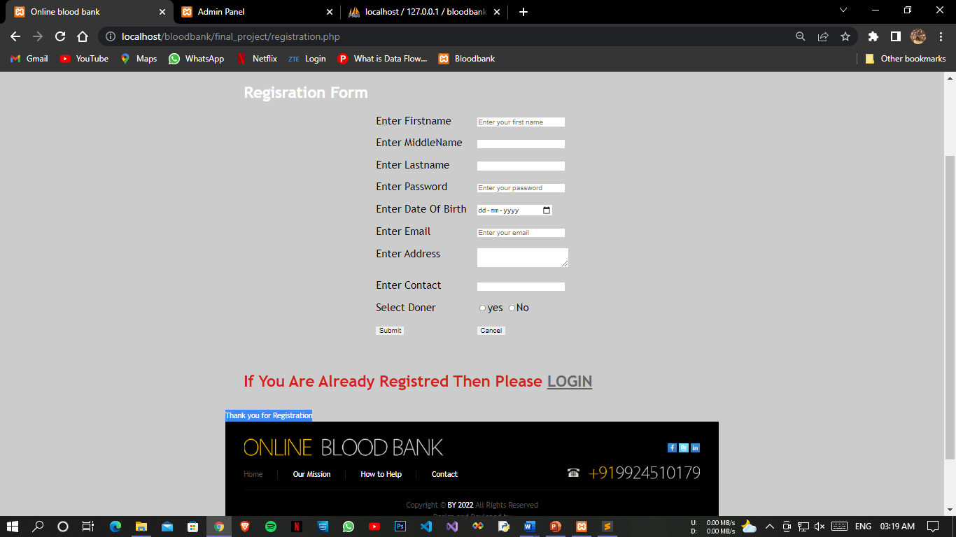
Registration Form Successful

Slide 21
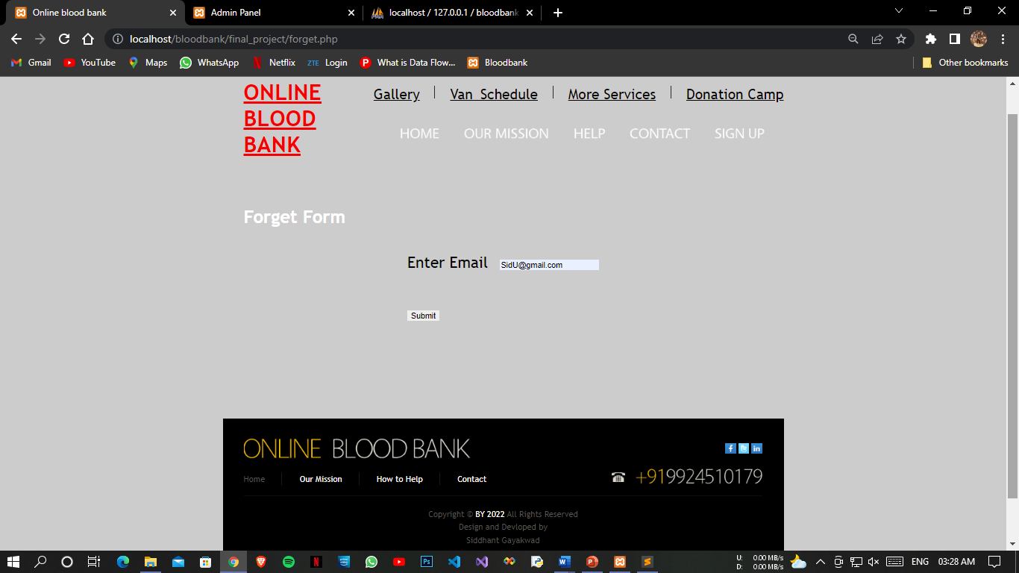
Password Forget Page

Slide 22
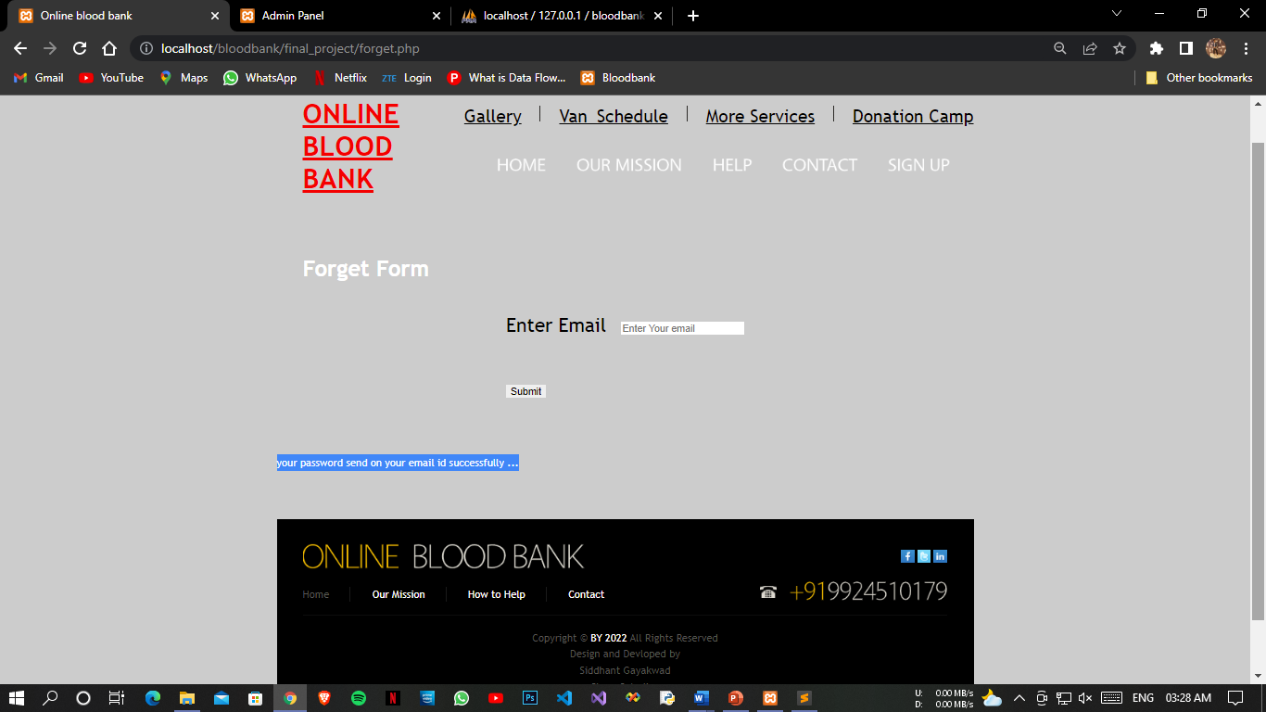
Forget Password Successfully page

Slide 23
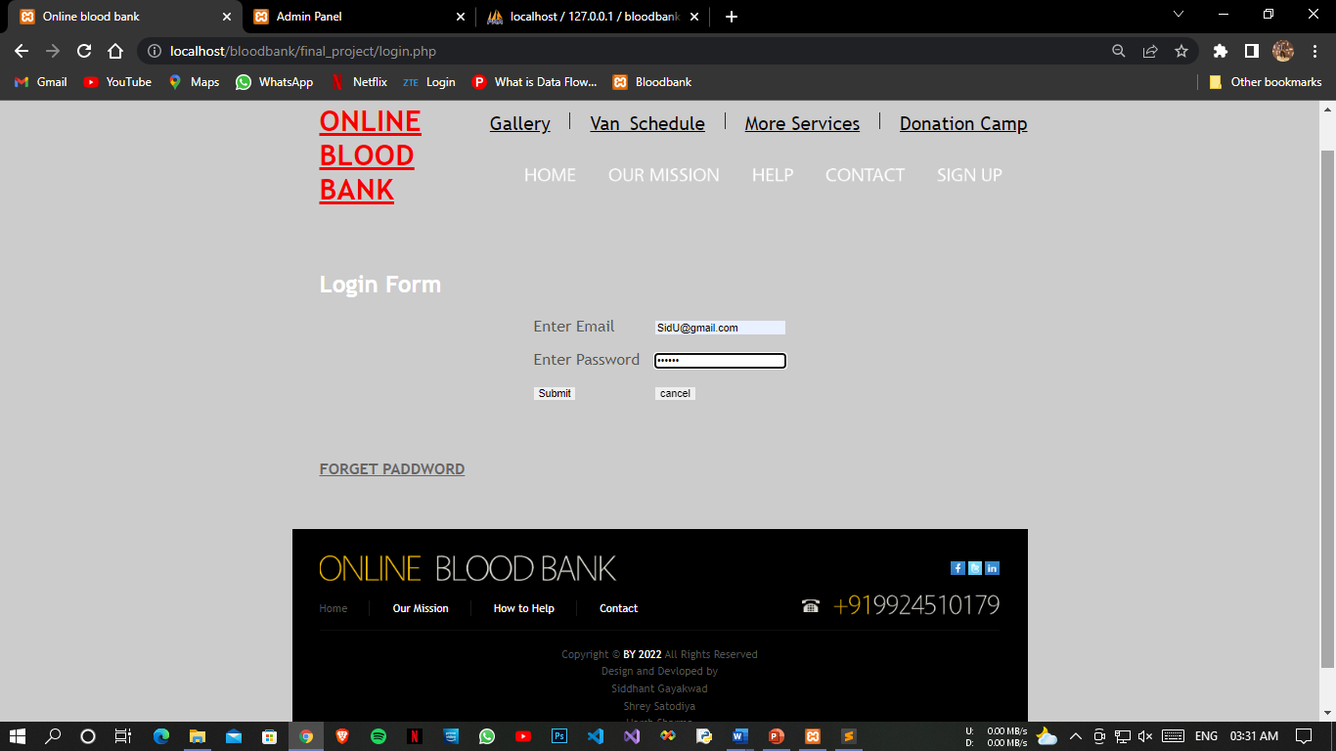
Login Page

Slide 24
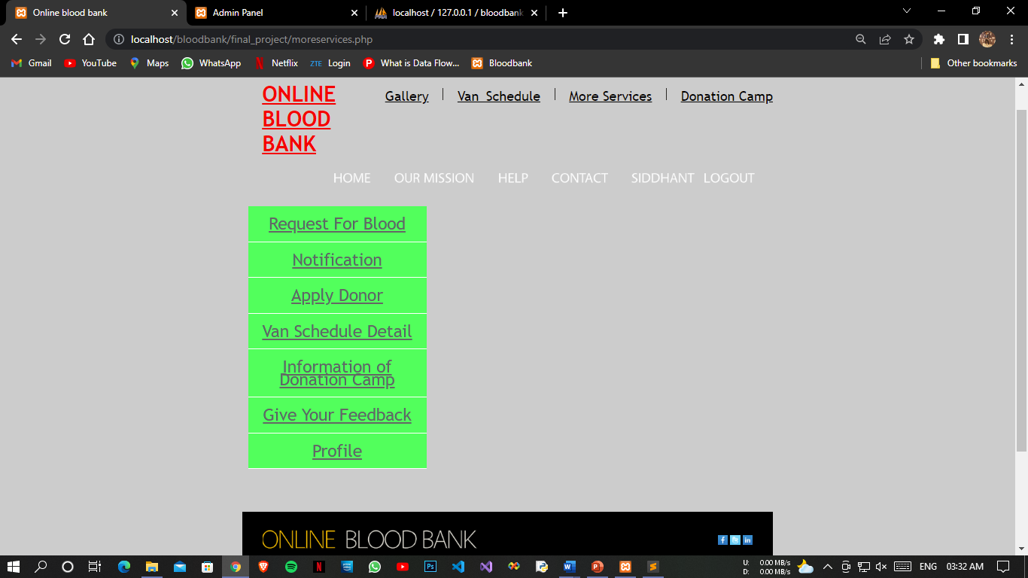
Login Successful Page

Slide 25
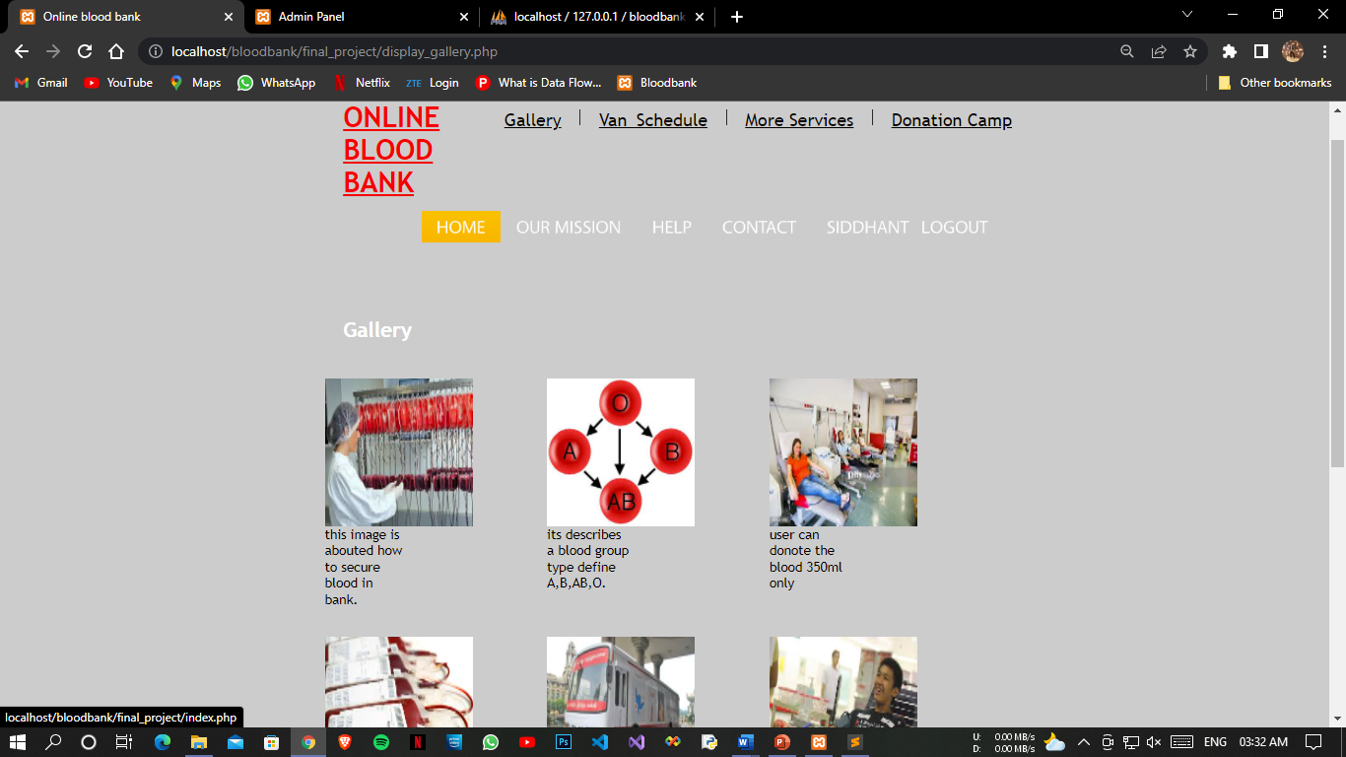
Gallery Page

Slide 26
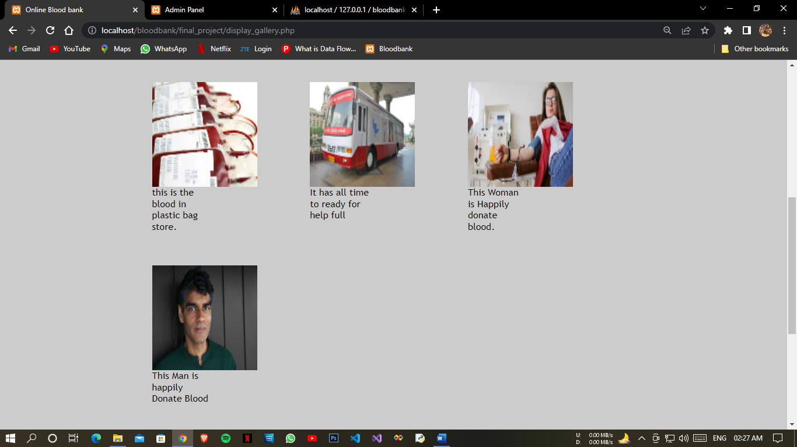
Gallery Page 2

Slide 27
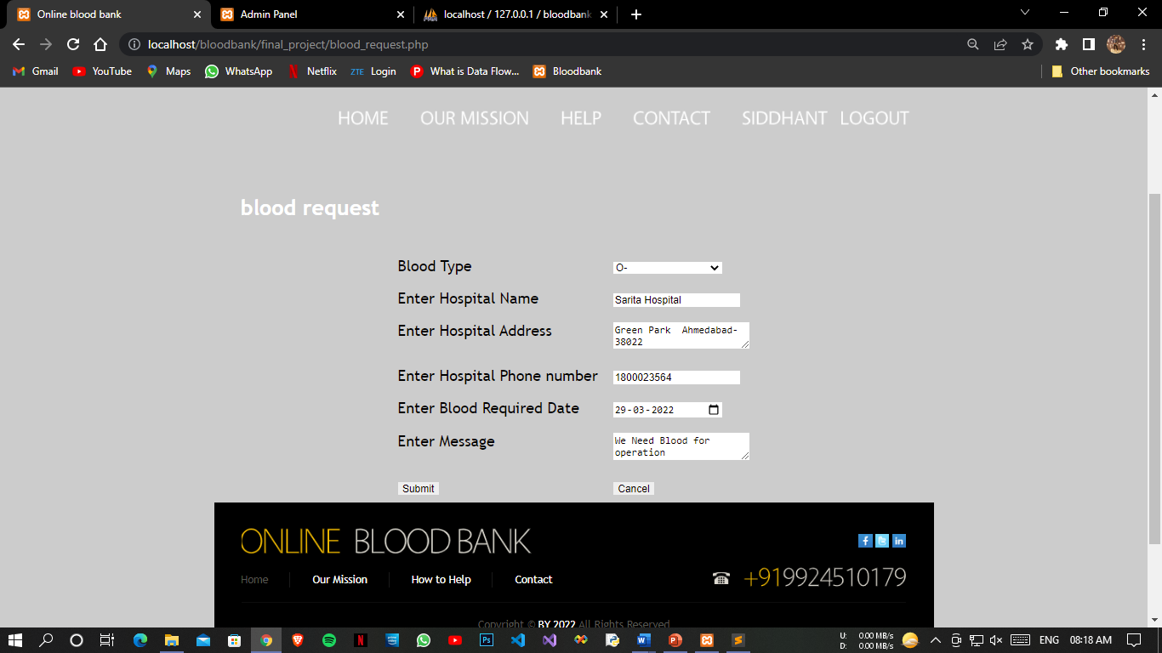
Blood Request

Slide 28
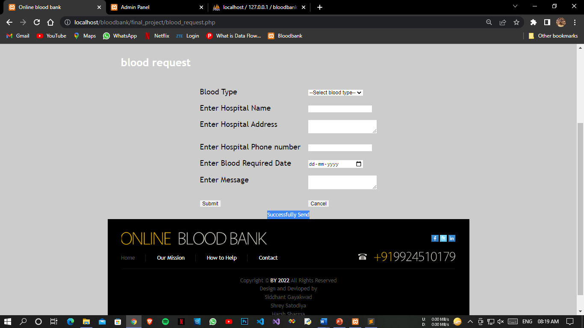
Successful Blood Request

Slide 29
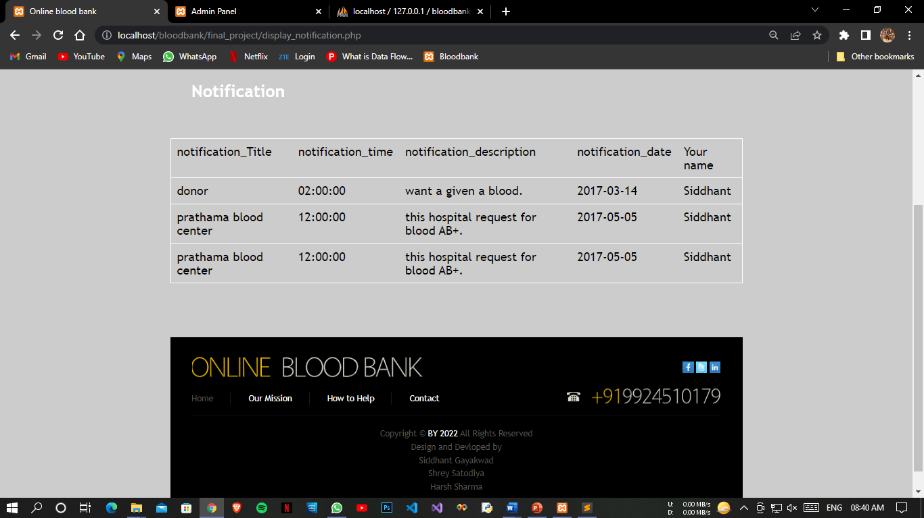
Notification

Slide 30
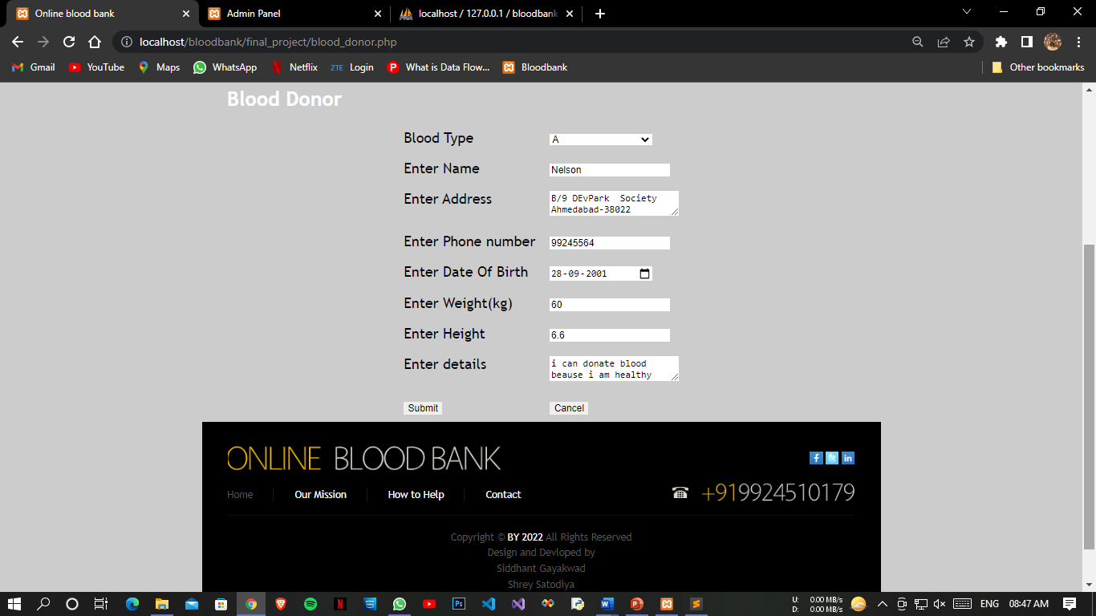
Apply for Doner

Slide 31
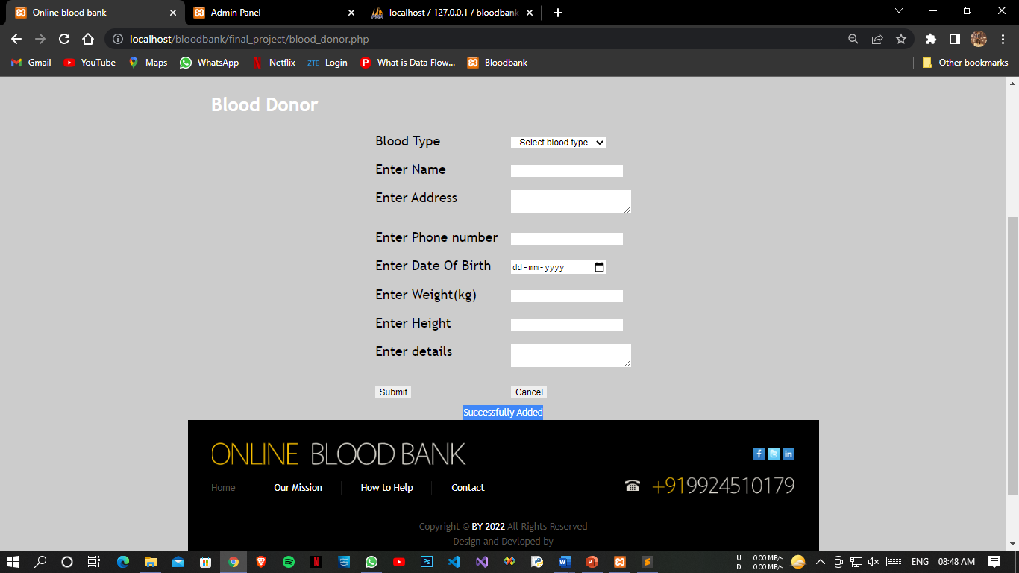
Successful Apply Doner

Slide 32
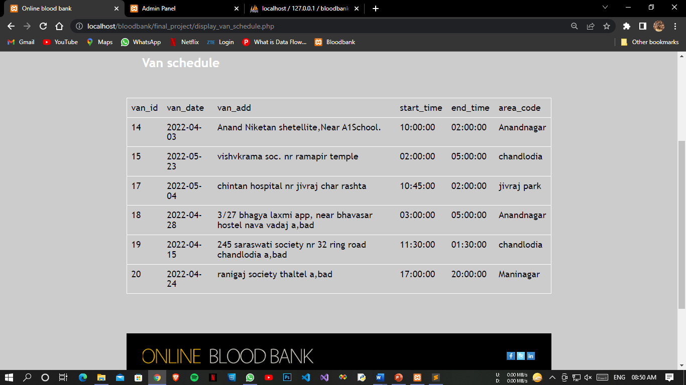
Van Schedule

Slide 33
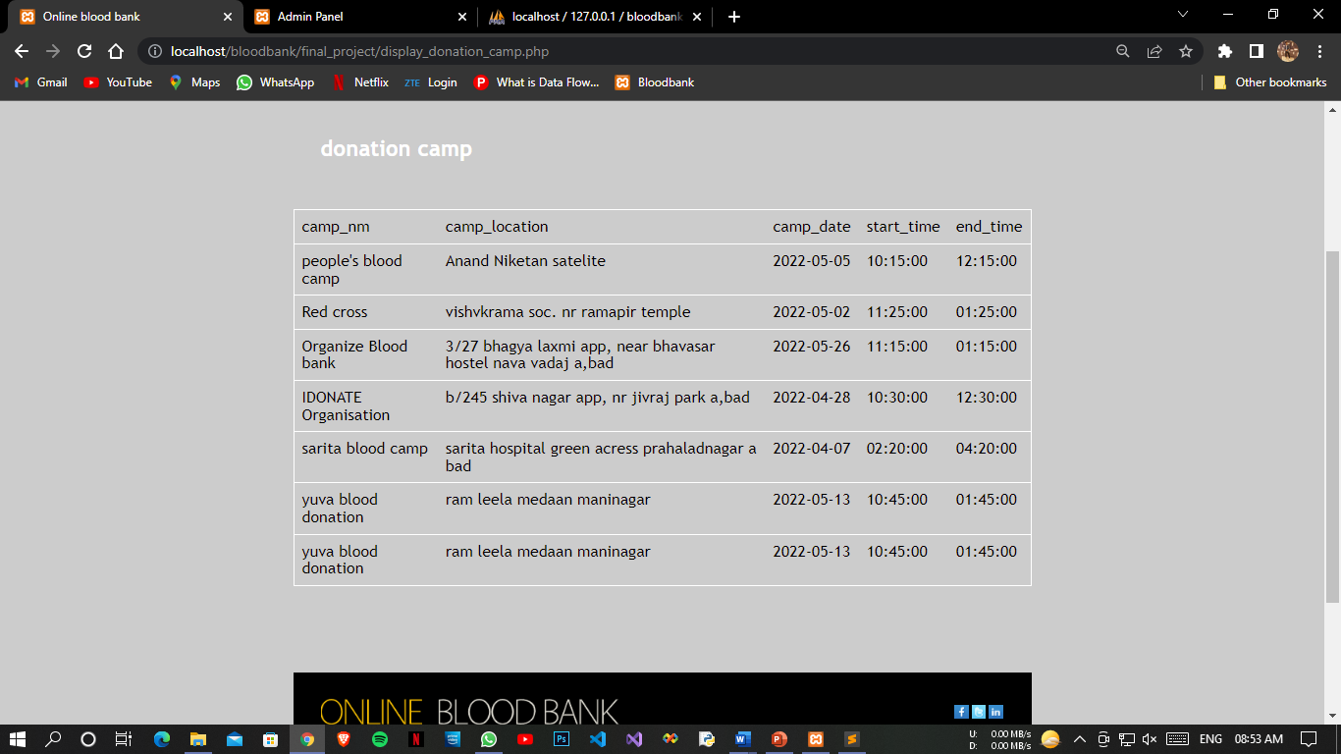
Donation Camp

Slide 34
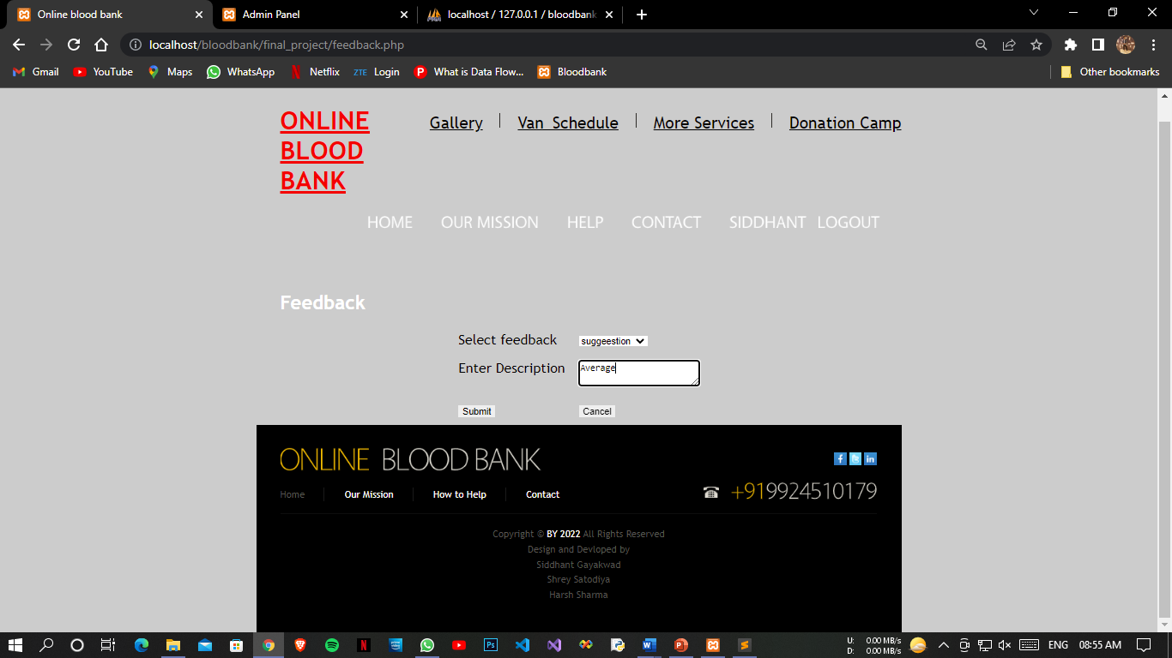
Feedback

Slide 35
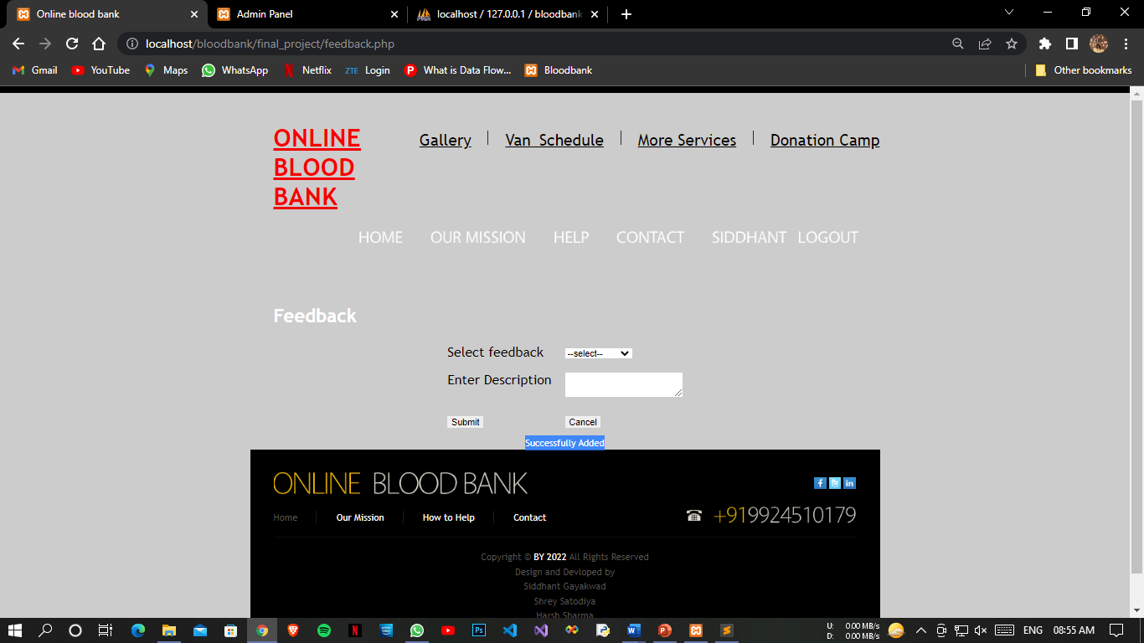
Feedback Successfully

Slide 36
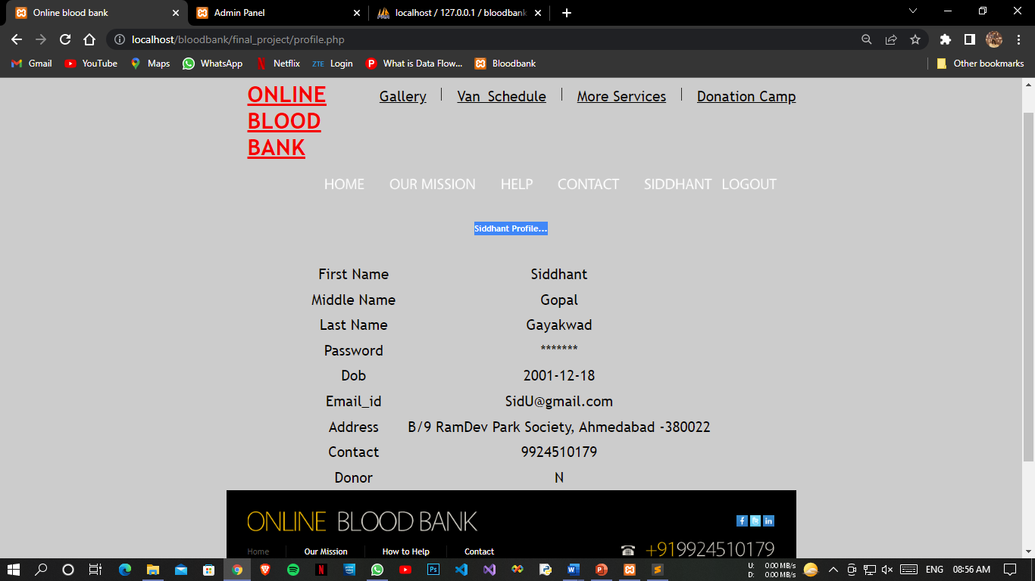
Profile Page

Slide 37
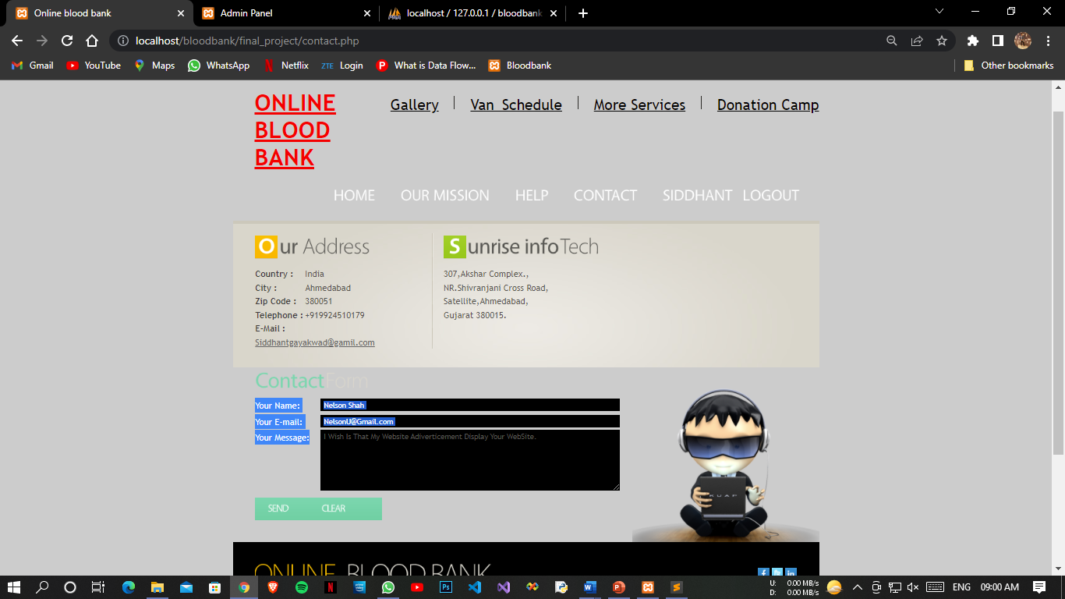
Contact Us Page

Slide 38
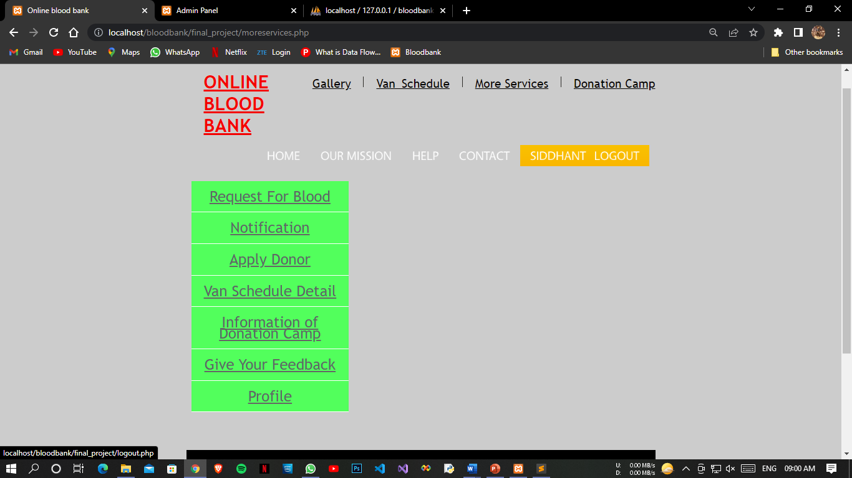
Logout Page

Slide 39
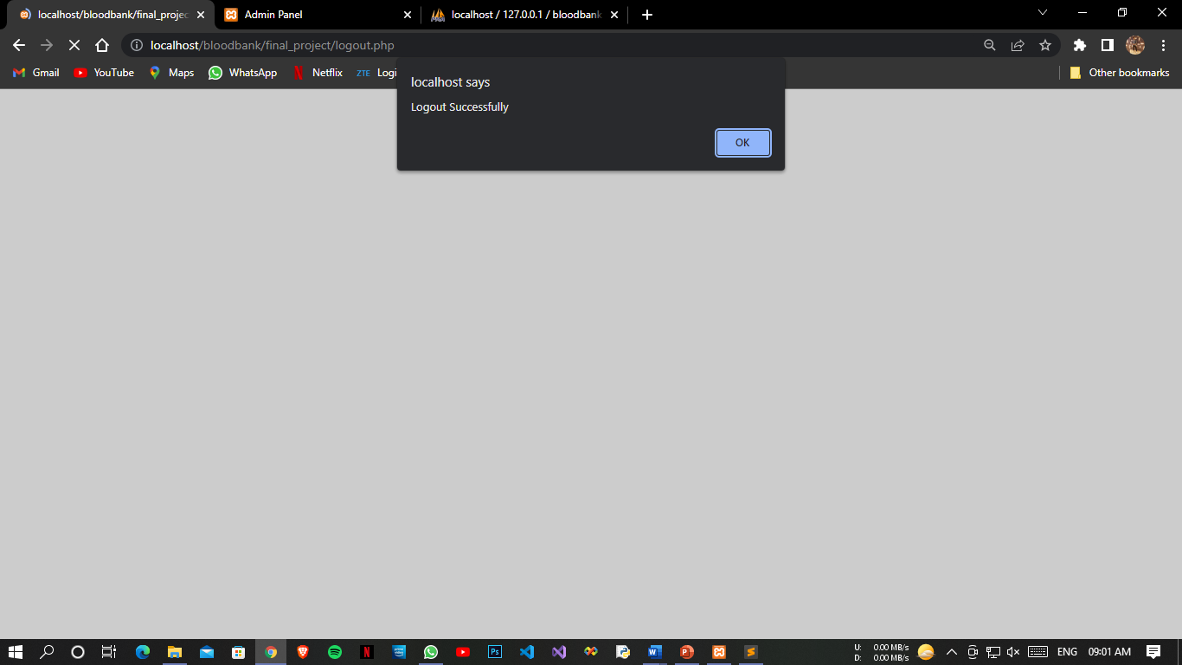
Logout Successfully

Slide 40
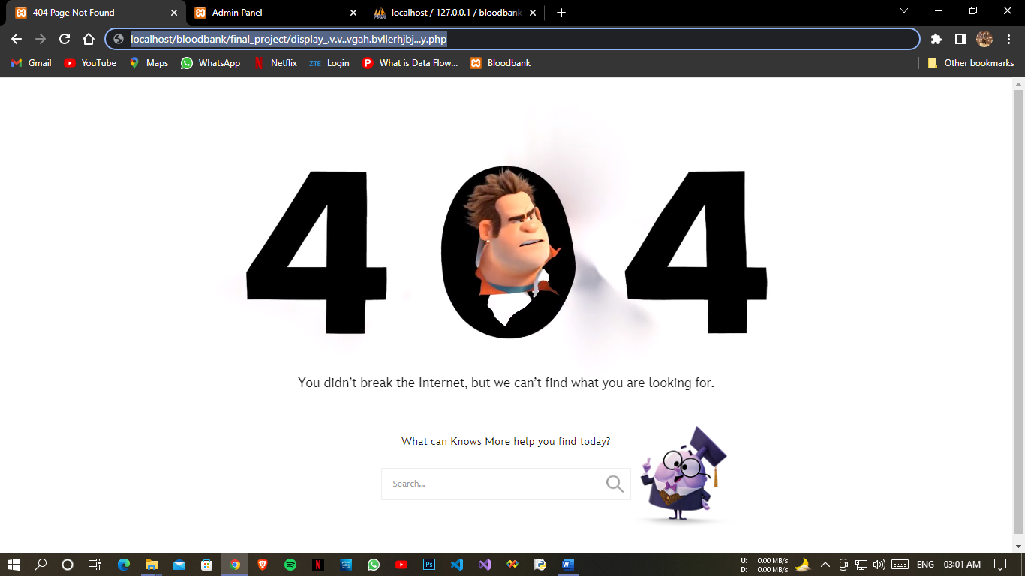
404 Error Page

Slide 41
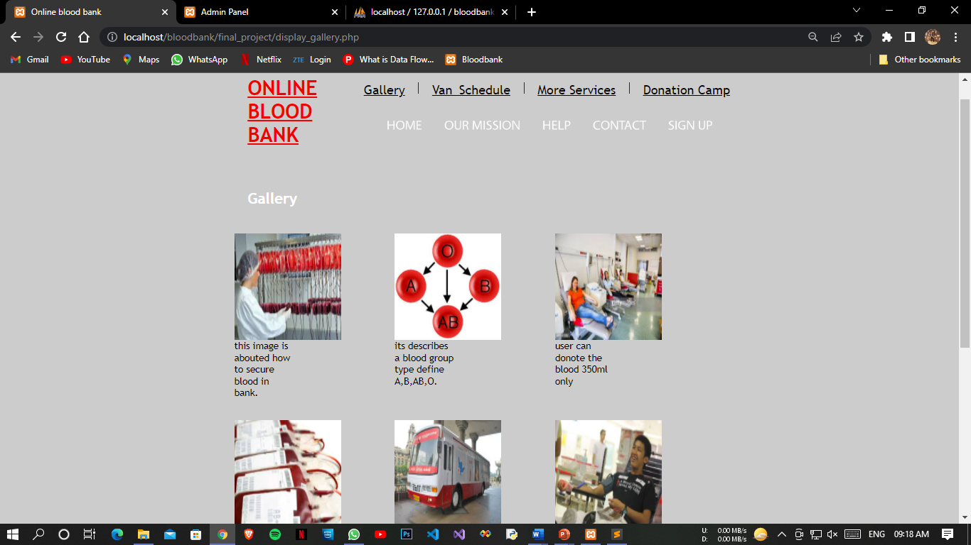
Guests
Gallery Page

Slide 42
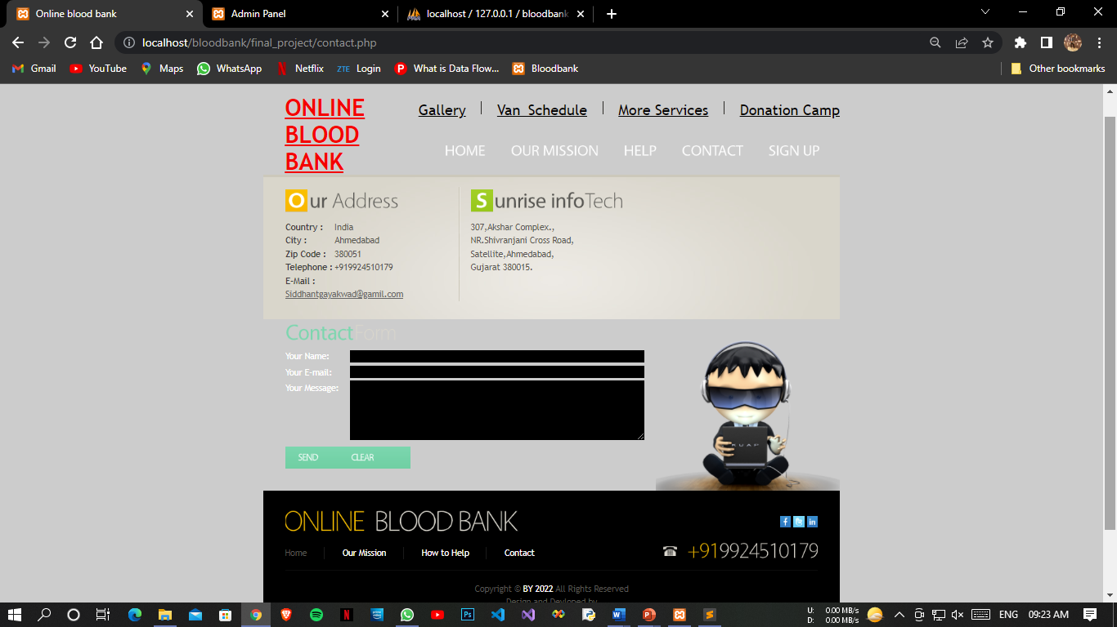
Contact Page

Slide 43
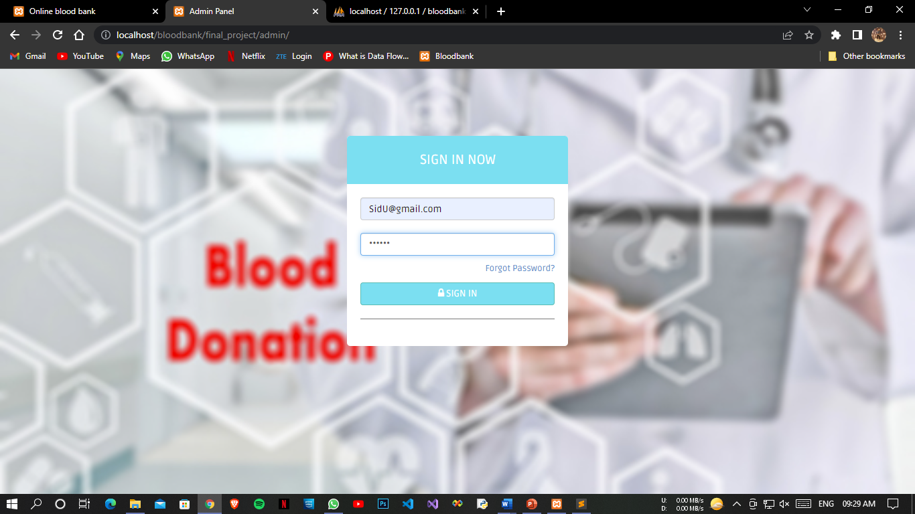
Admin
Login Page

Slide 44
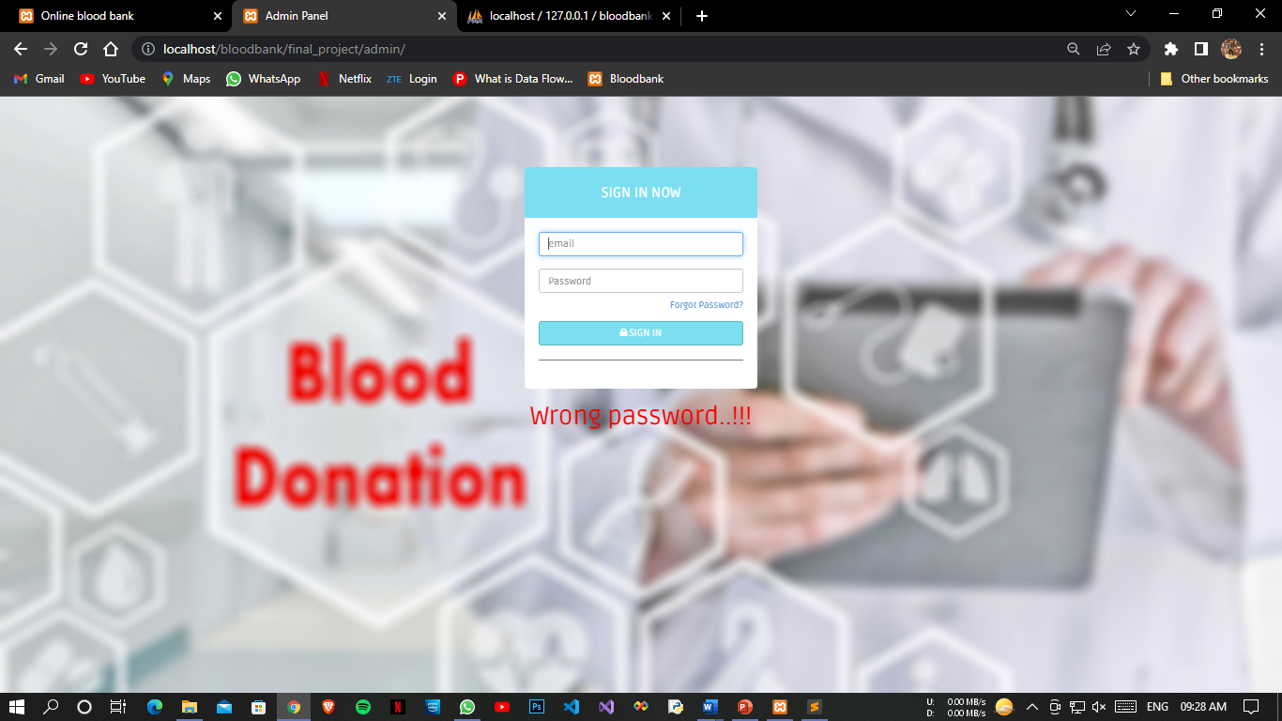
Admin Error Page

Slide 45
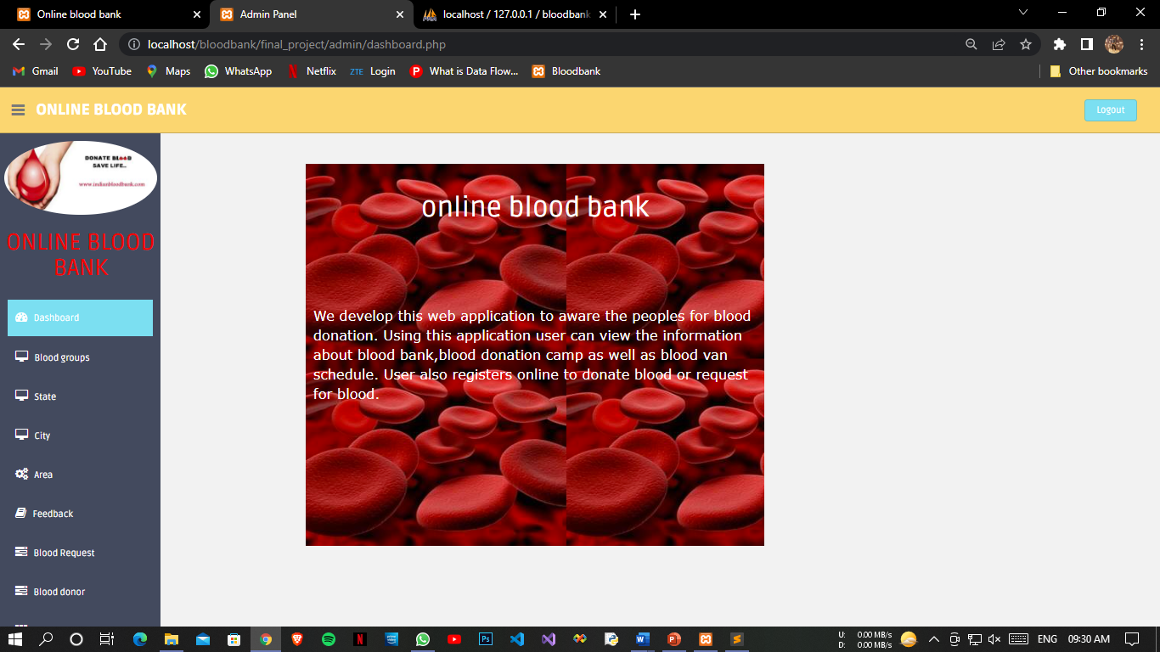
Login Successful

Slide 46
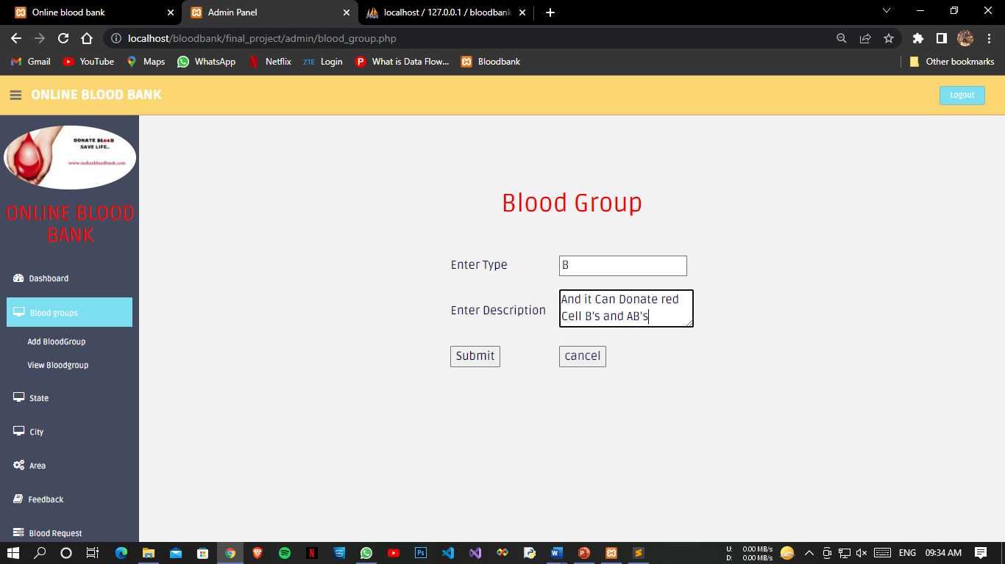
Blood Group Page

Slide 47
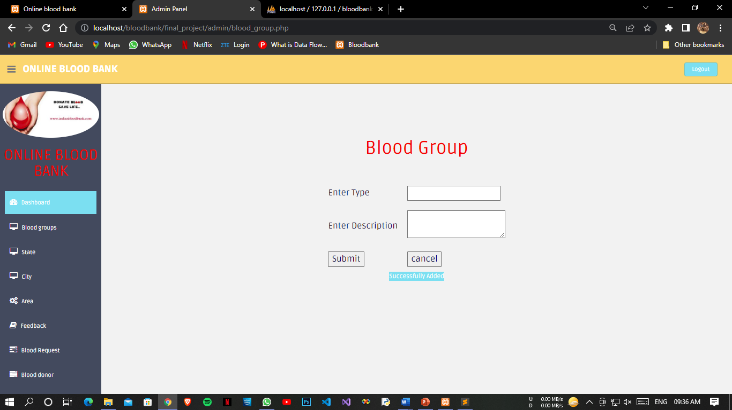
Added Successfully Blood Group

Slide 48
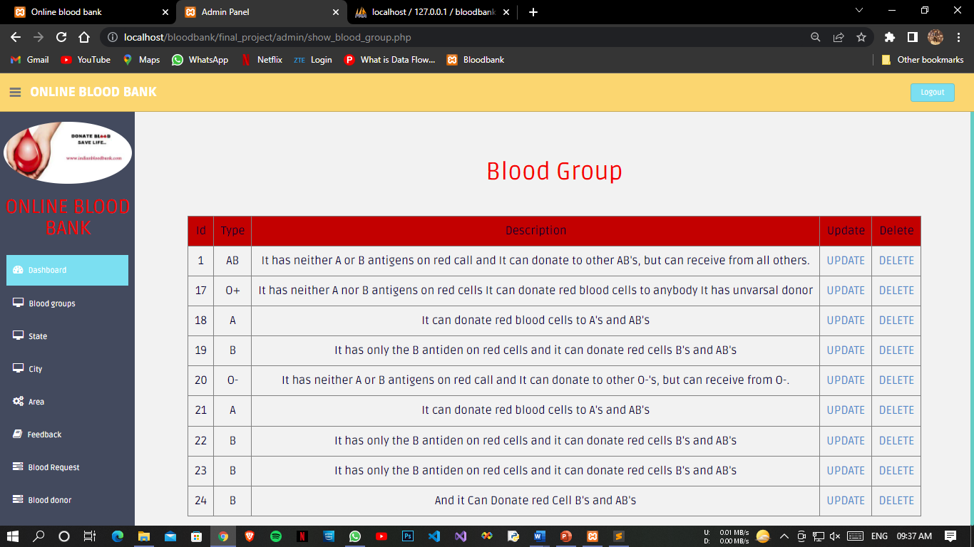
View Blood Group Page

Slide 49
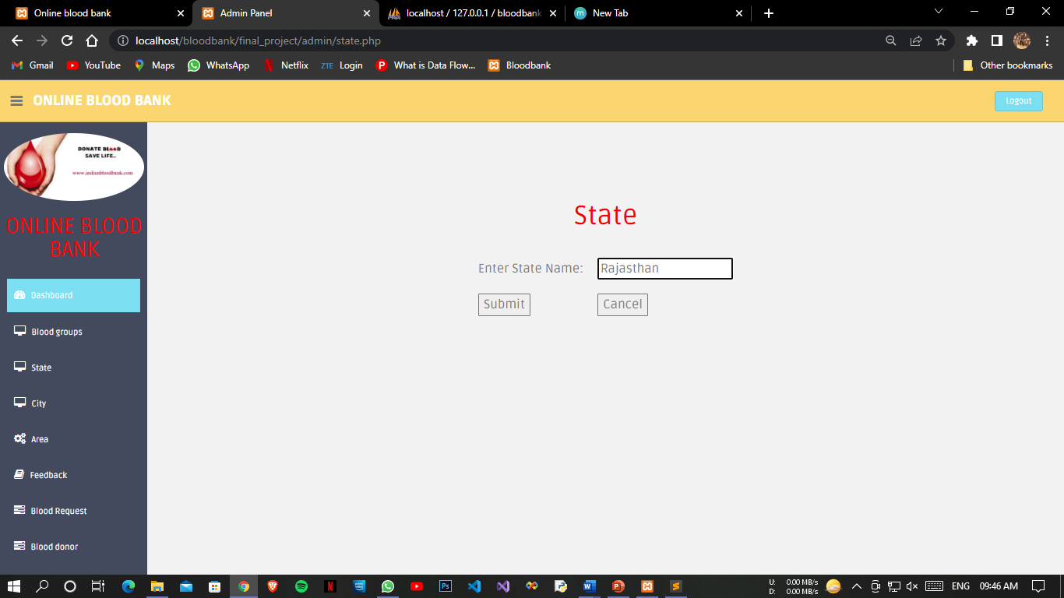
State Page

Slide 50
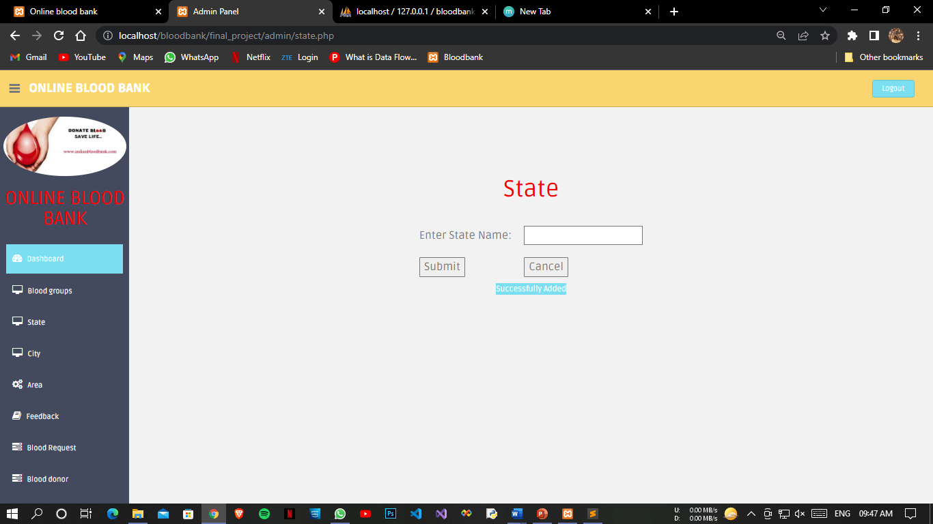
Added State Successfully

Slide 51
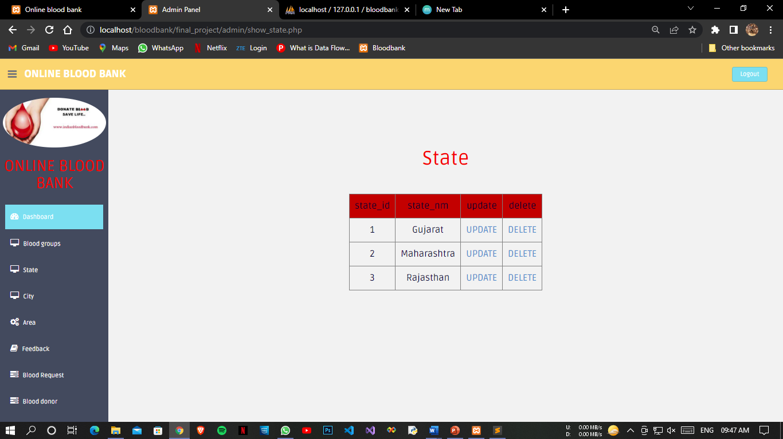
View State Page

Slide 52
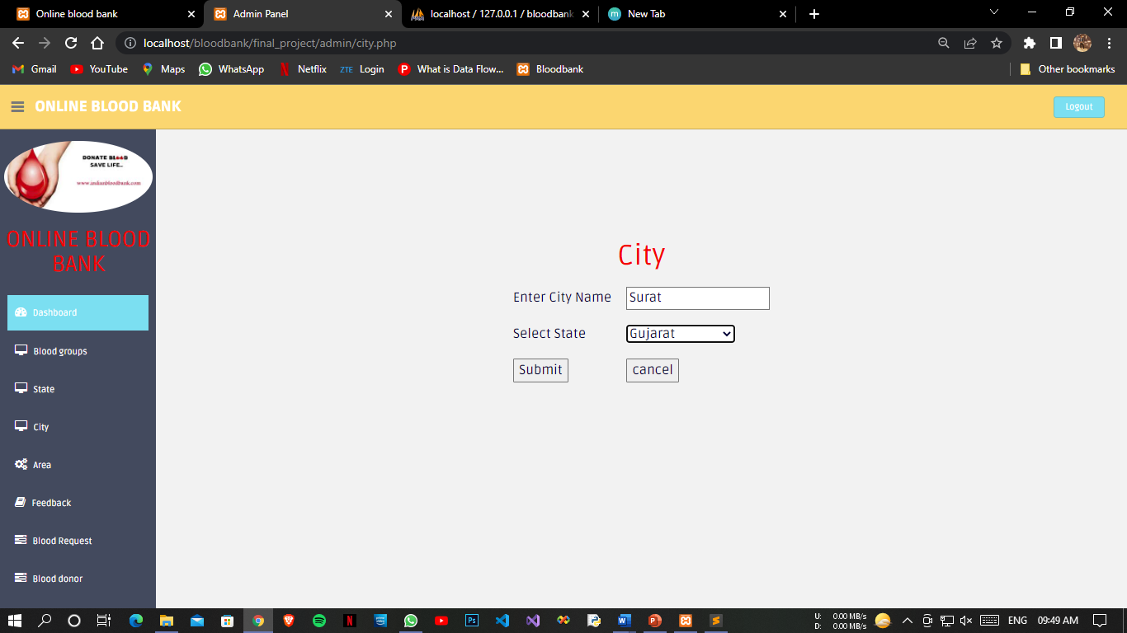
Add City

Slide 53
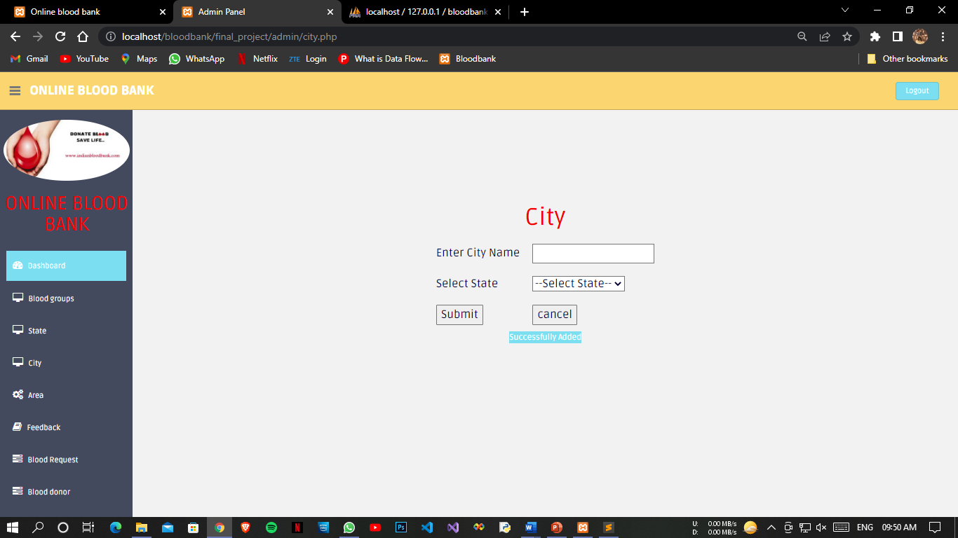
Added City Successful Page

Slide 54
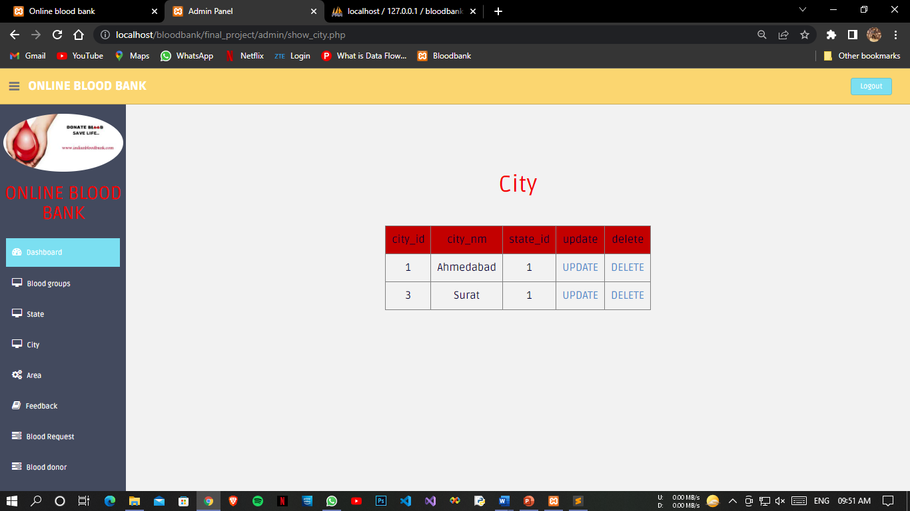
Updated City Page

Slide 55
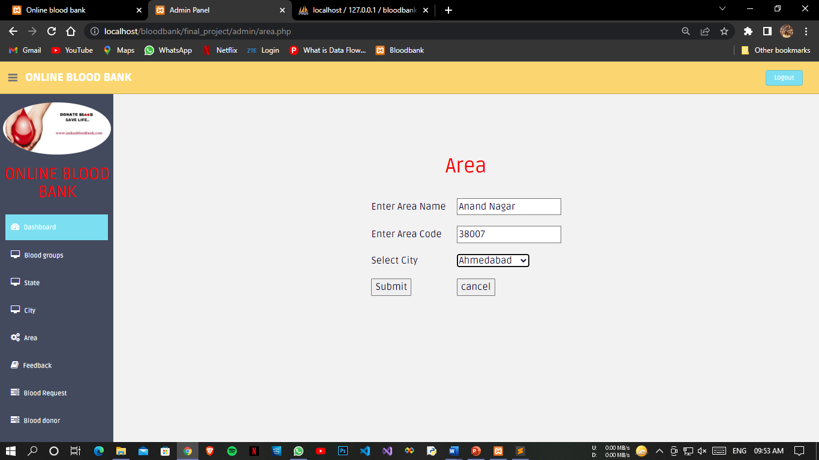
Area Page

Slide 56
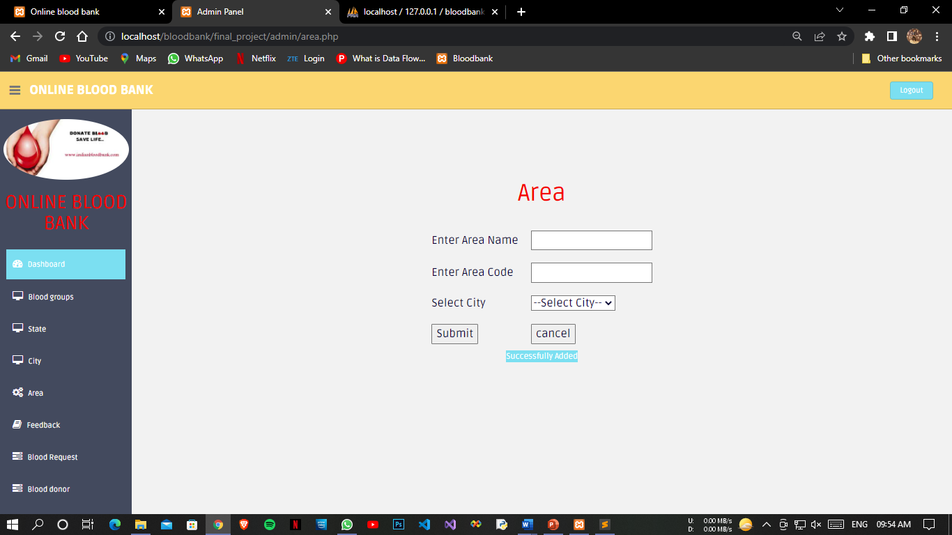
Added Area successful Page

Slide 57
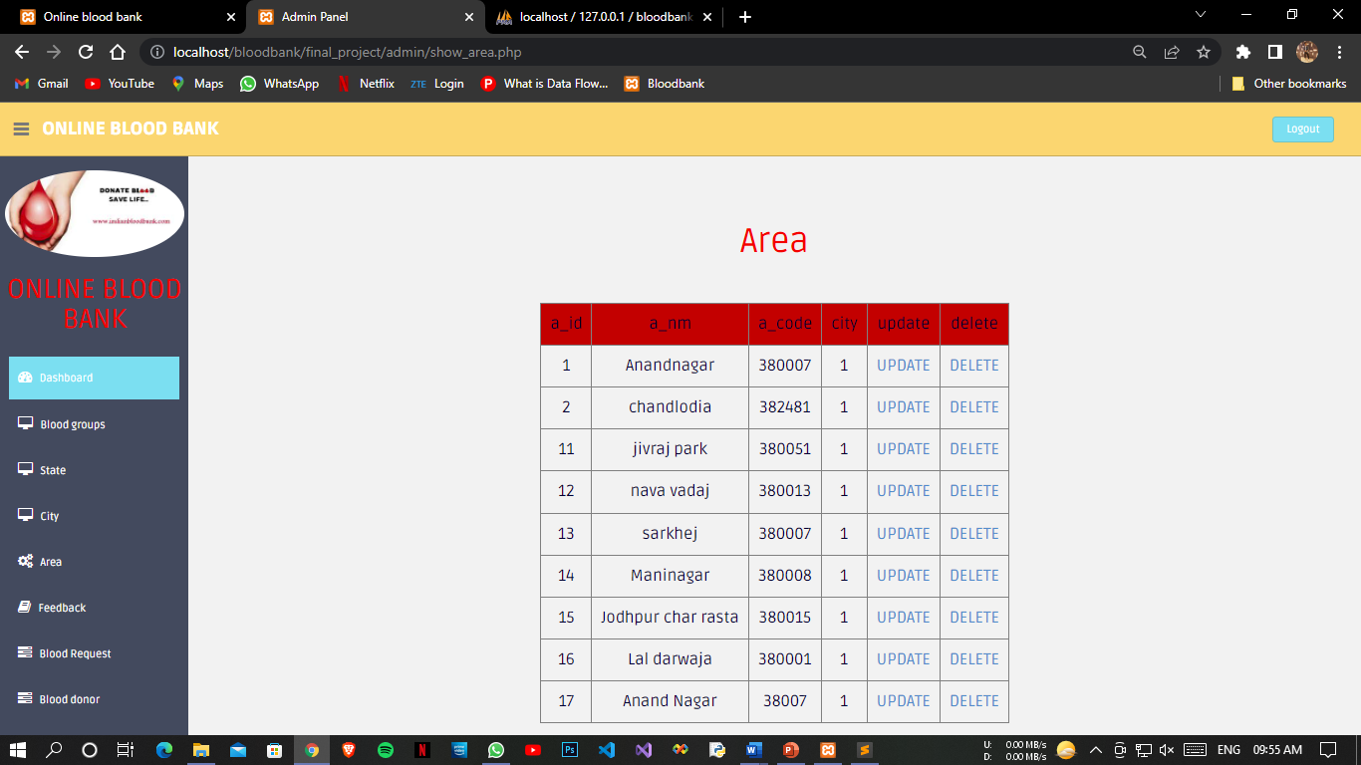
Updated Area Page

Slide 58
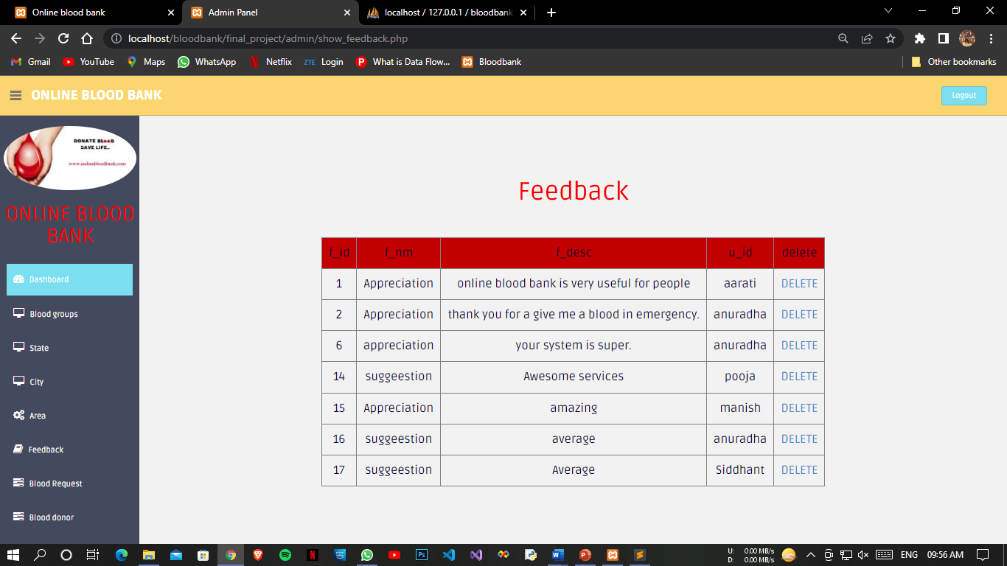
Feedback Page

Slide 59

Blood Request Page

Slide 60

Change Request Status Page

Slide 61

Reply For Blood Request Page

Slide 62

Delete Past Blood Requests Page

Slide 63

Successful Delete Blood Requests Page

Slide 64

Blood Donors Page

Slide 65

Add Blood Camp Page

Slide 66

Successful Add Blood Camp Page

Slide 67

Blood Camp List Page

Slide 68

Add Gallery Page

Slide 69

Successfully Added Gallery Page

Slide 70

Updated Gallery Page

Slide 71

Adding Notification Details

Slide 72

Successful Add Notification

Slide 73

Updated Notification

Slide 74

Adding Van Schedule Page

Slide 75

Successfully Added van Schedule

Slide 76

Updated van Schedule

Slide 77

Added van Schedule Area

Slide 78

Updated van Schedule Area

Slide 79

Updated Contact

Slide 80

Manage User Page

Slide 81

Deleting User

Slide 82

Delete User Successfully

Slide 83

Reports
Report Home

Slide 84

Blood Report

Slide 85

Blood Report Print

Slide 86
Generate Pdf

Slide 87

Blood Request Report

Slide 88

Blood Donor Report

Slide 89

Blood Camp Report

Slide 90

Notification Report

Slide 91

Van Schedule Report

Slide 92

Contact Report

Slide 93

User Report

Slide 94

Feedback Report

Slide 95
Future Enhancement
The planning that goes into implementing a project.
The importance of proper planning and an organized methodology.
The key element of team spirit and co-ordination in a successful project.
BLOOD BANK MANAGEMENT is a software application to build such a way that it should suits for all type of blood banks in future.
One important future scope is availability of location-based blood bank details and extraction of location-based donor's detail, which is very helpful to the acceptant people. All the time the network facilities cannot be use. This time donor request does not reach in proper time, this can be avoided through adding some message sending procedure this will help to find proper blood donor in time. This will provide availability of blood in time.

Slide 96
Bibliography
Reference Books:
Fundamentals of Database System
Reference Websites
Google
Wikipedia
https://www.scribd.com
https://www.slideshare.net
https://www.google.com

Slide 97


